Slide 1



Slide 2

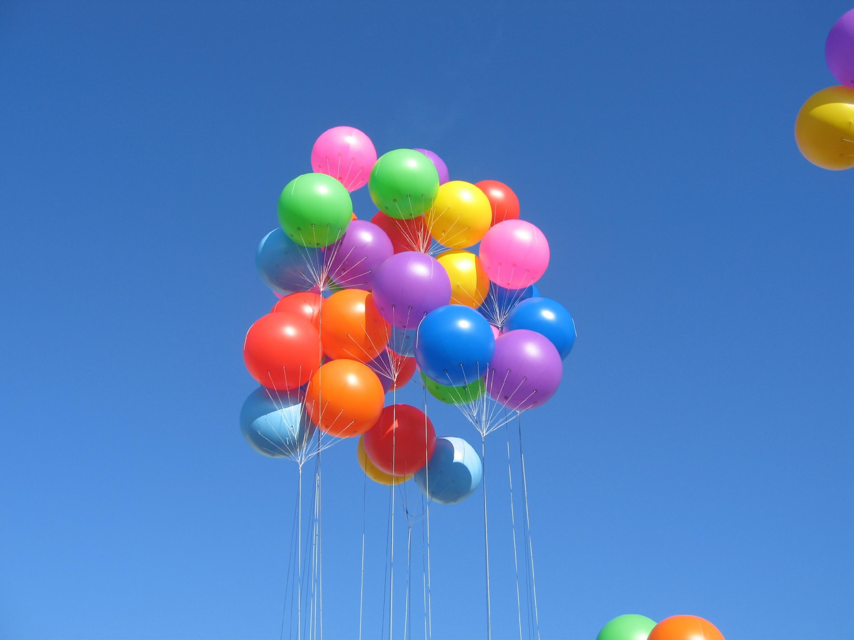
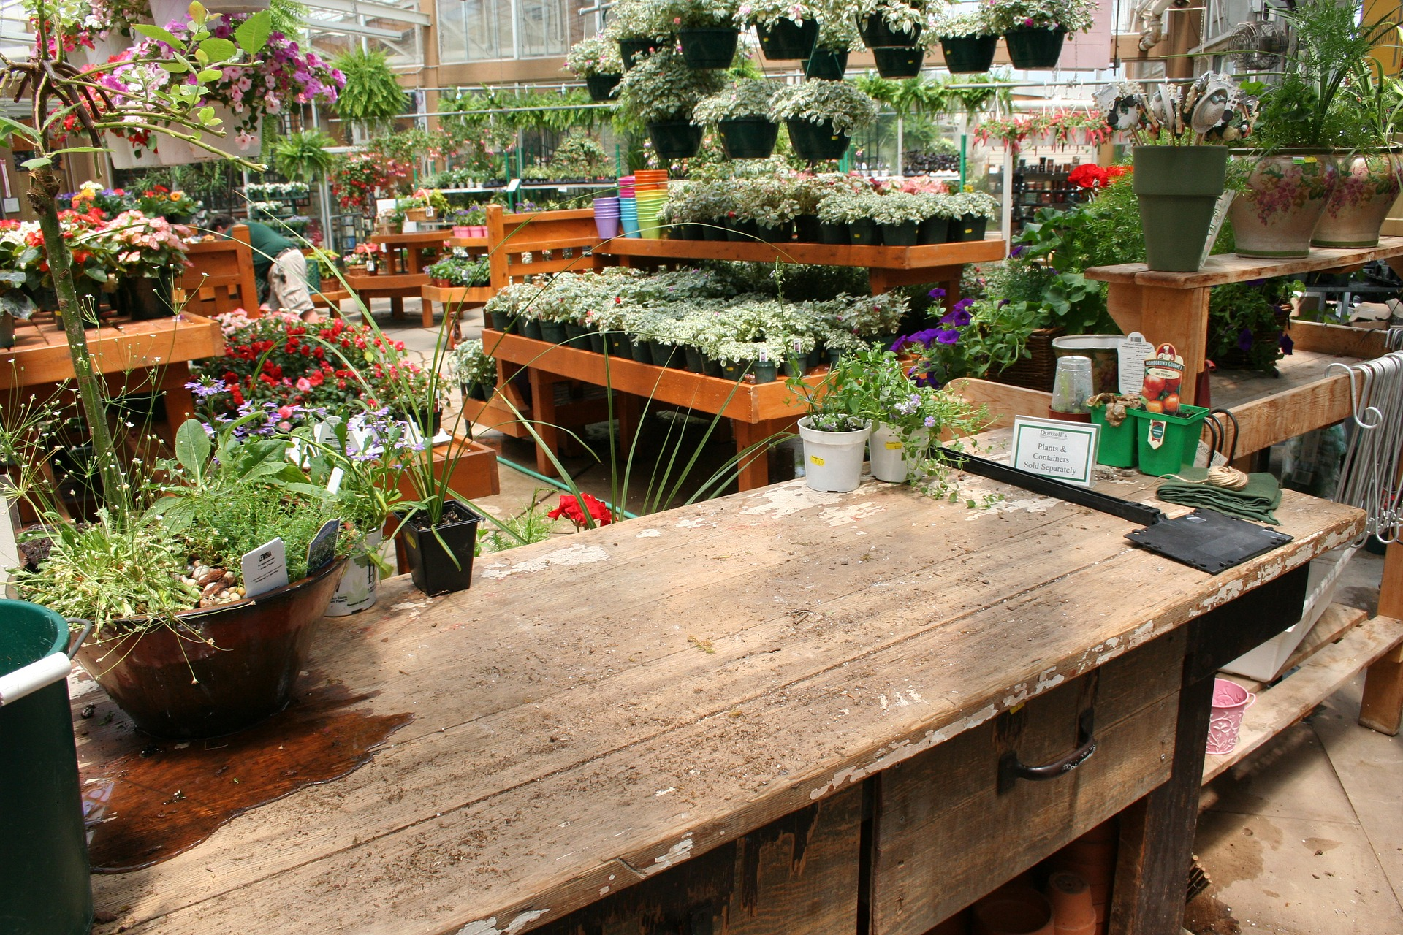
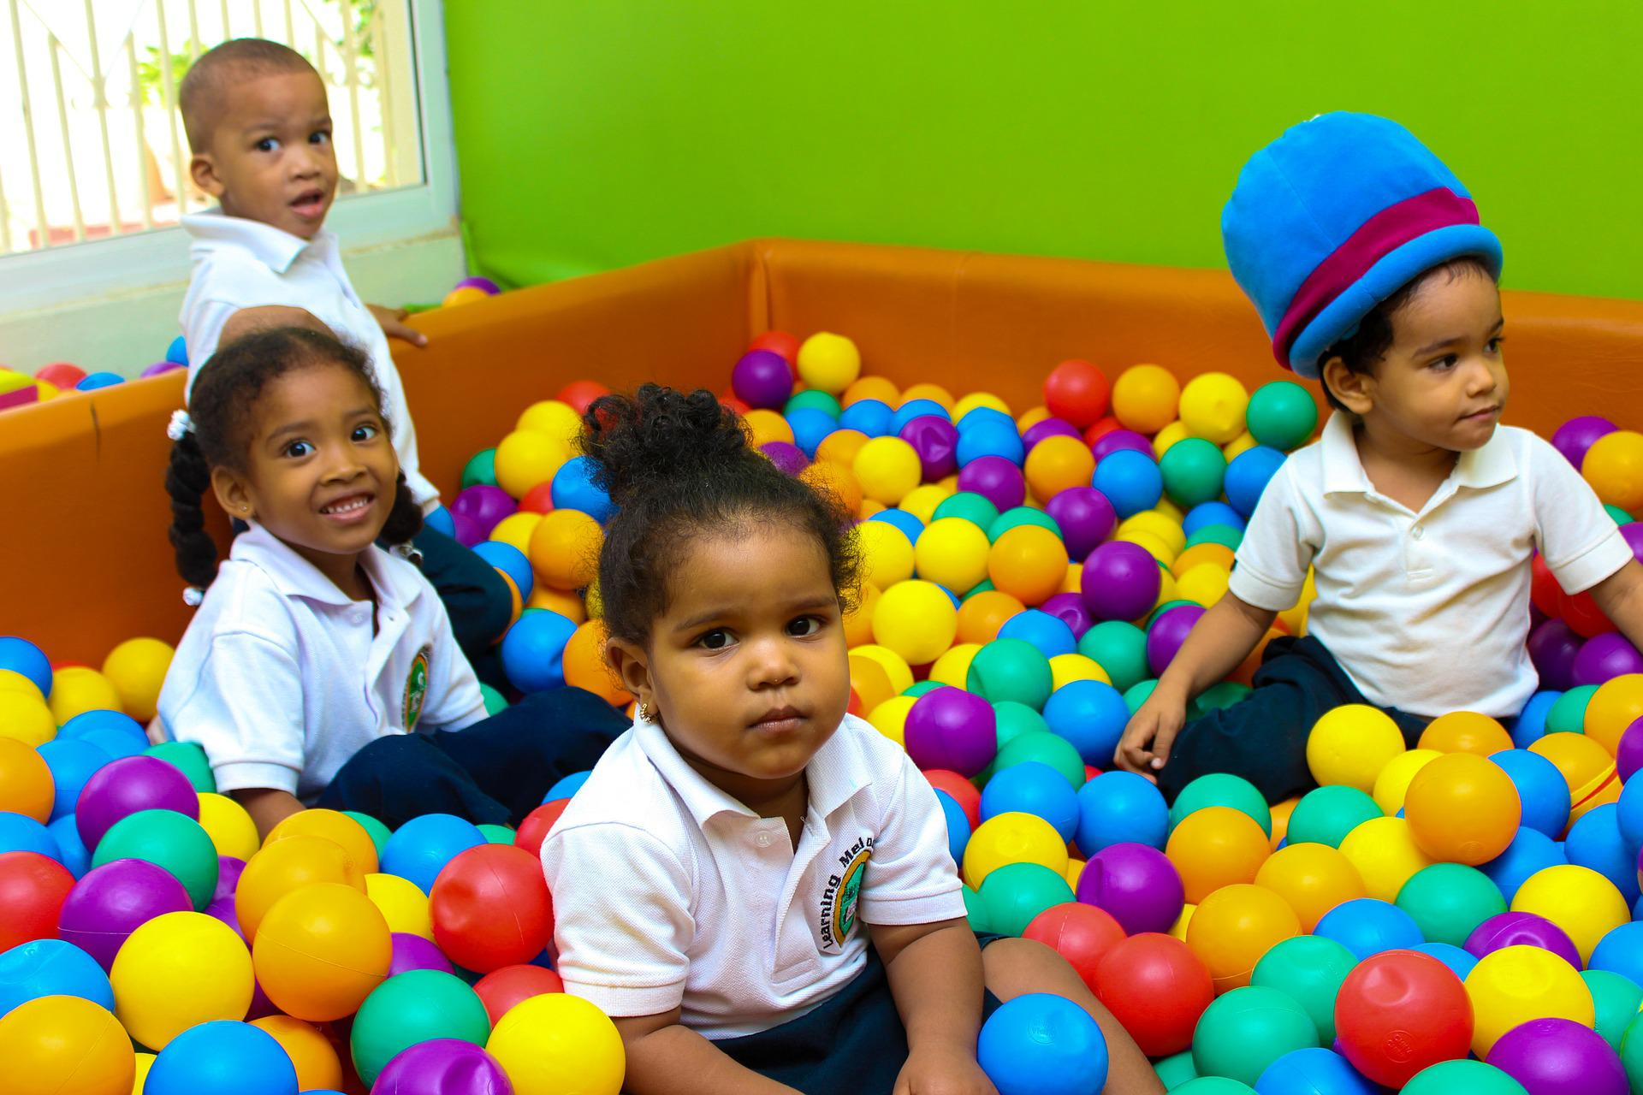
What is a business?
  An organisation that produces and/or sells goods or services and a place where people work.

Slide 3
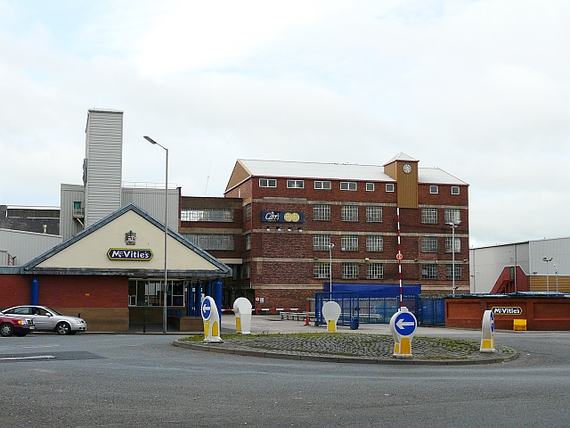
Is this a small, medium or large business?

Slide 4
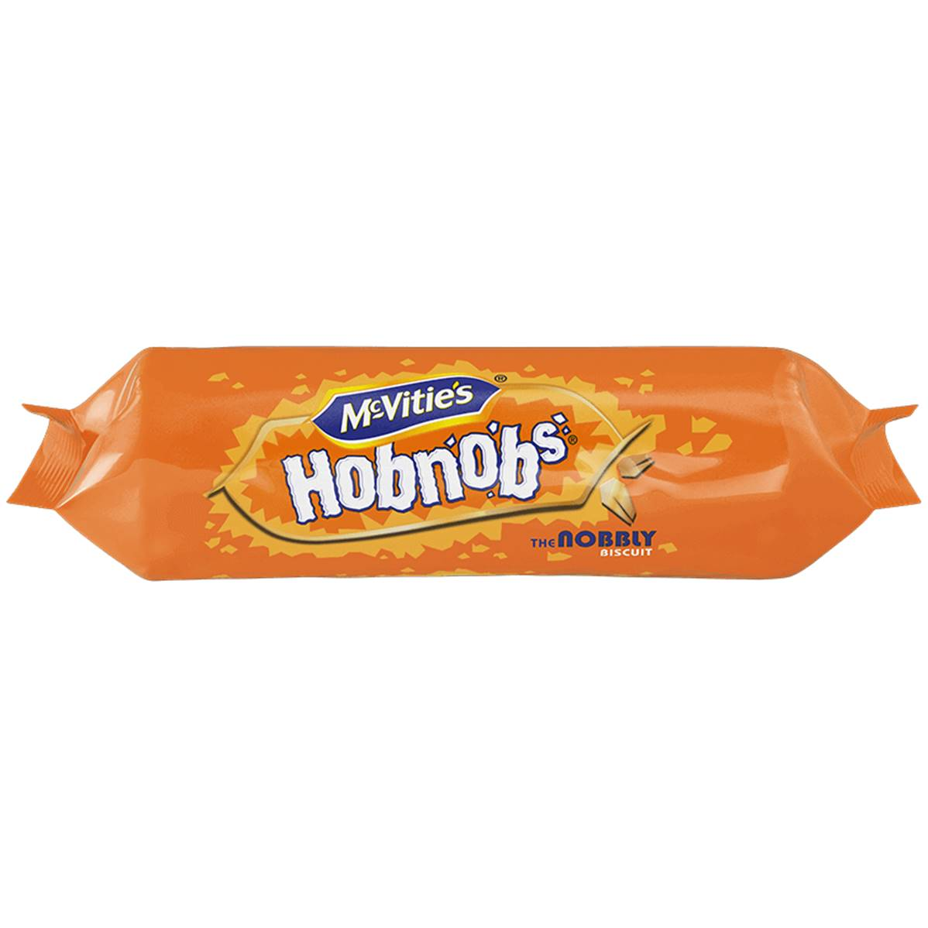
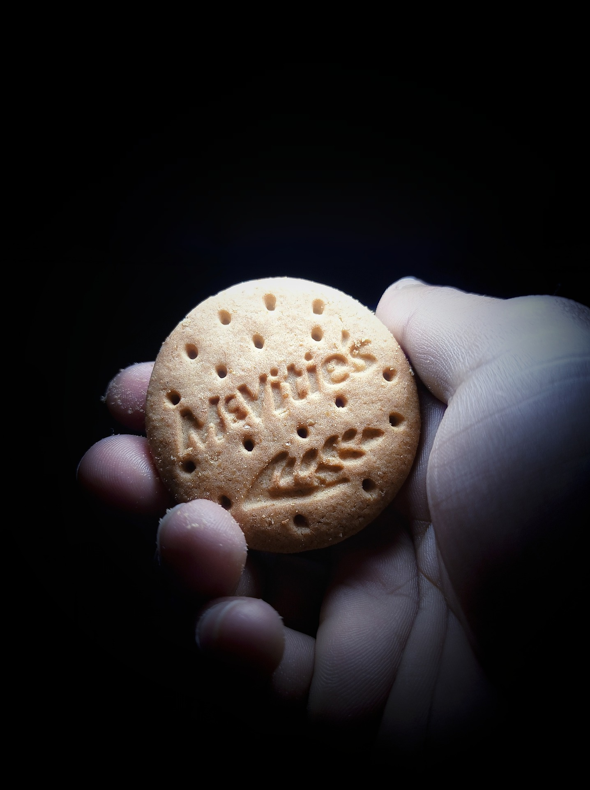
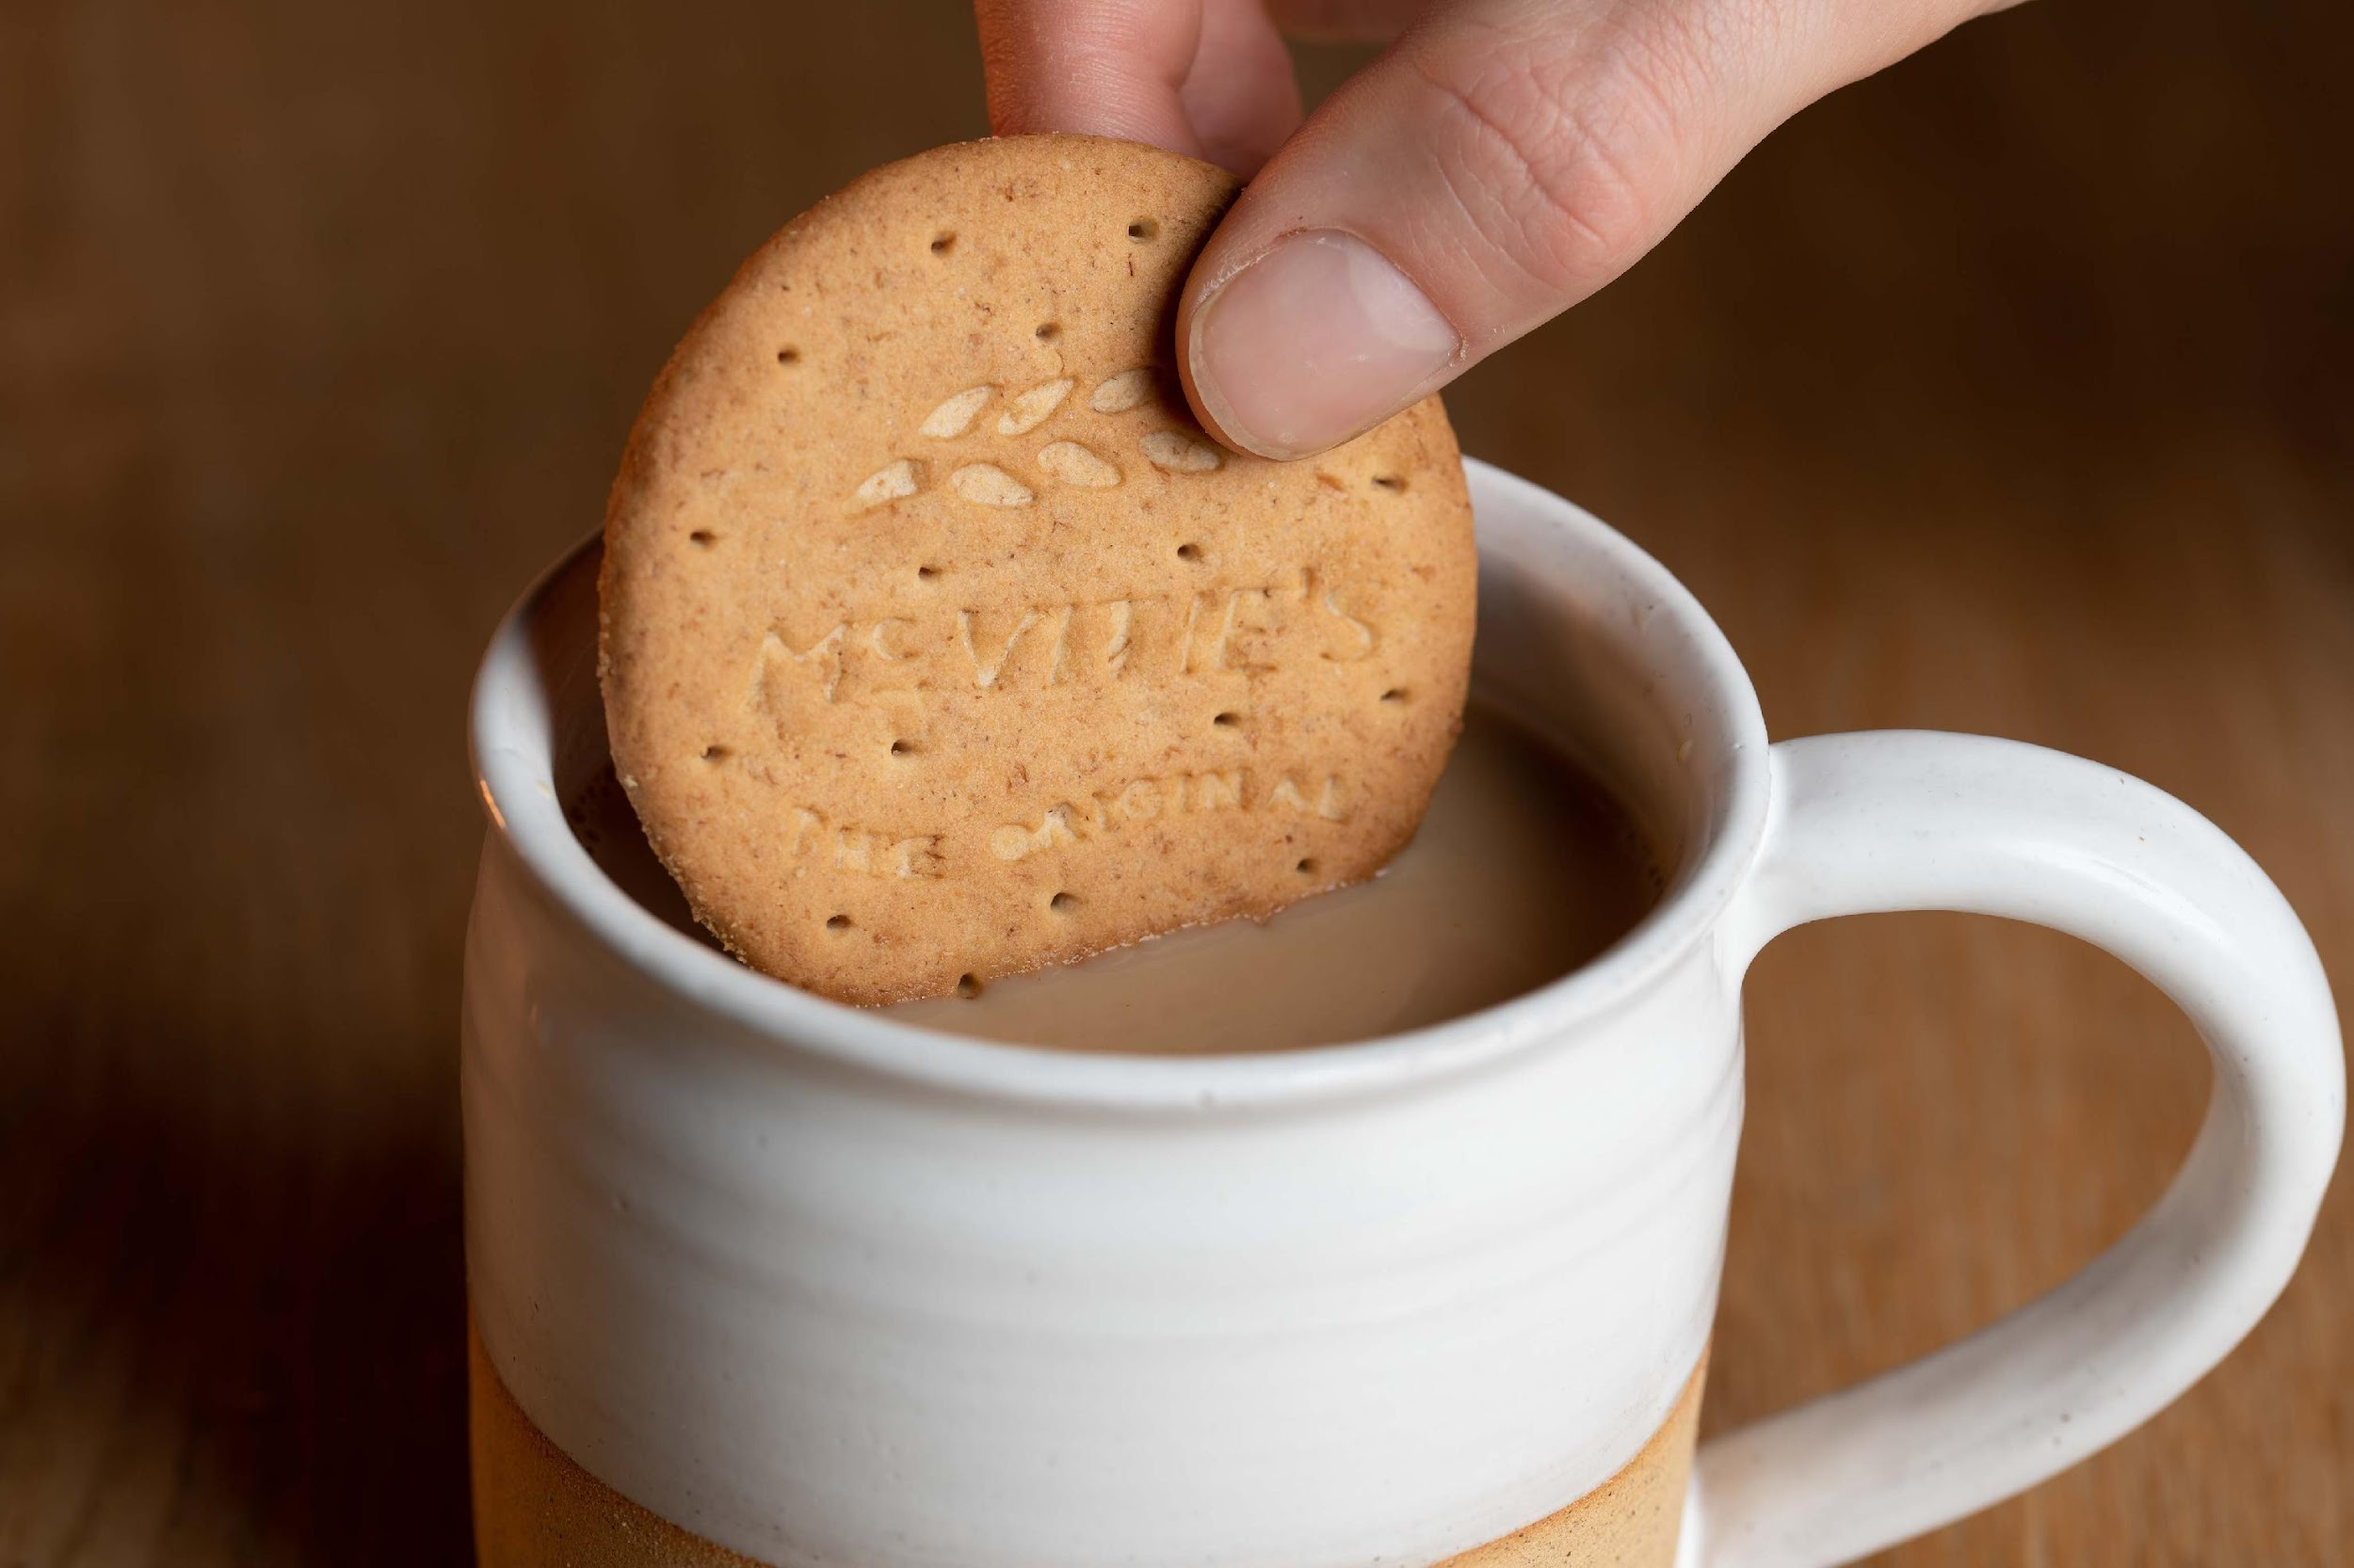
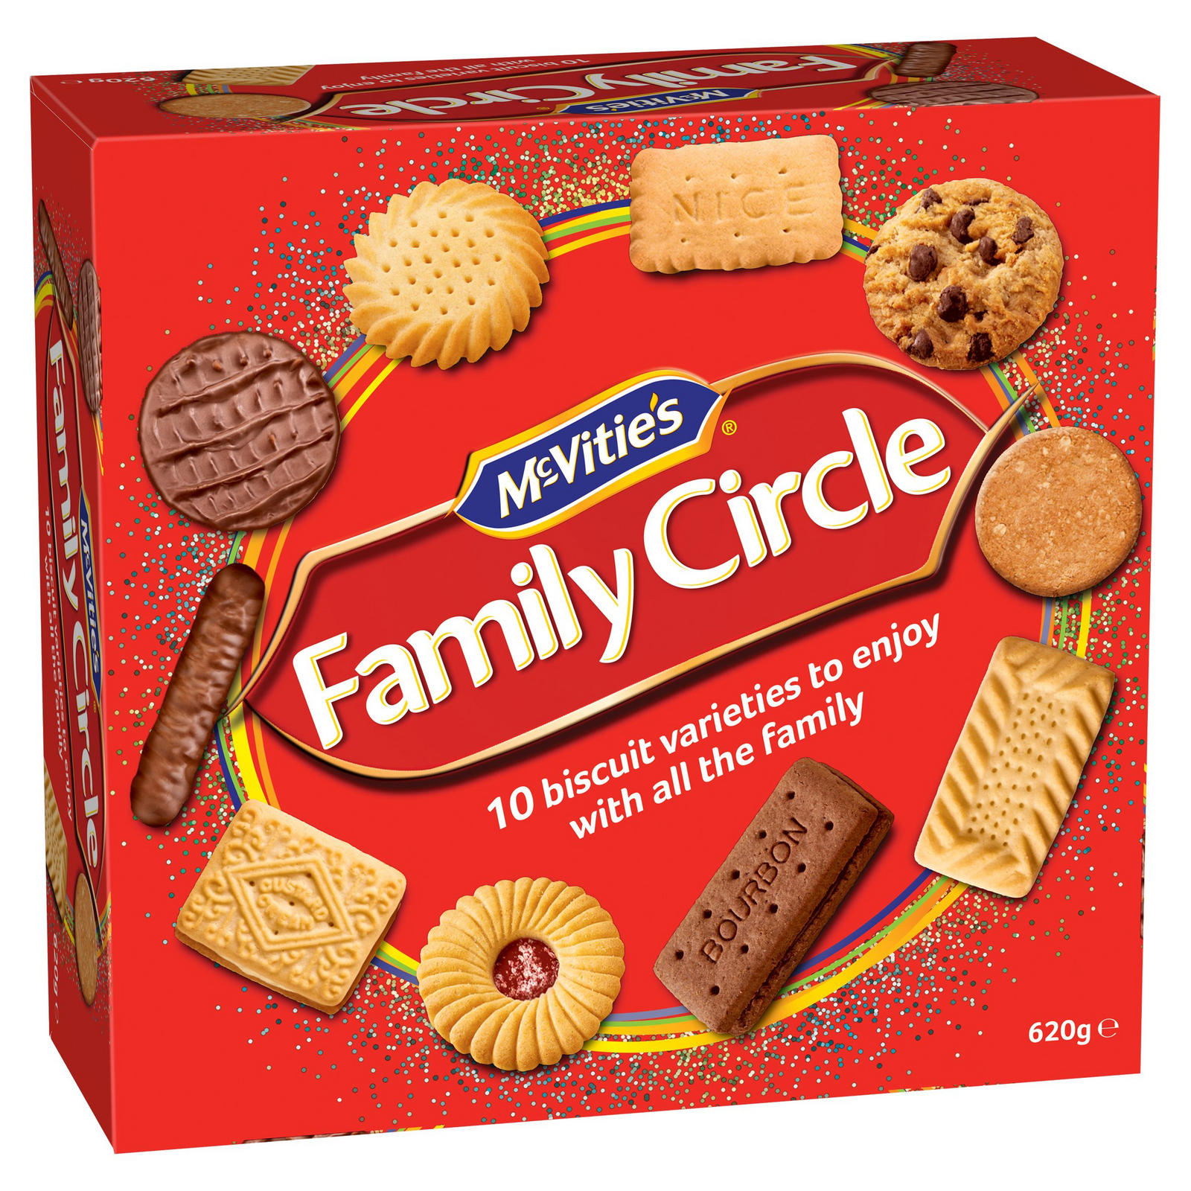
Does it provide goods or services?

Slide 5
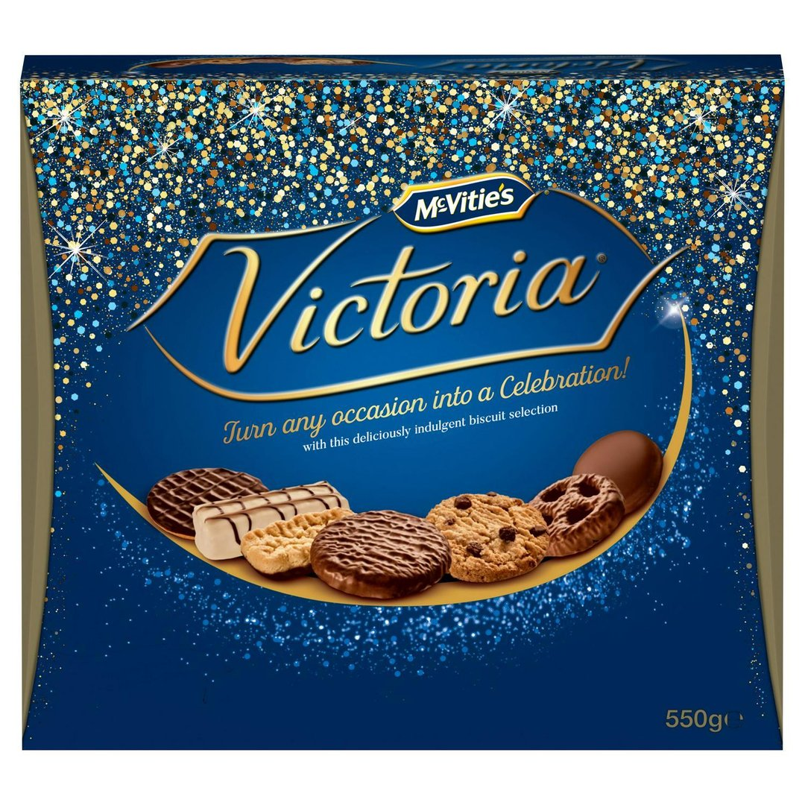
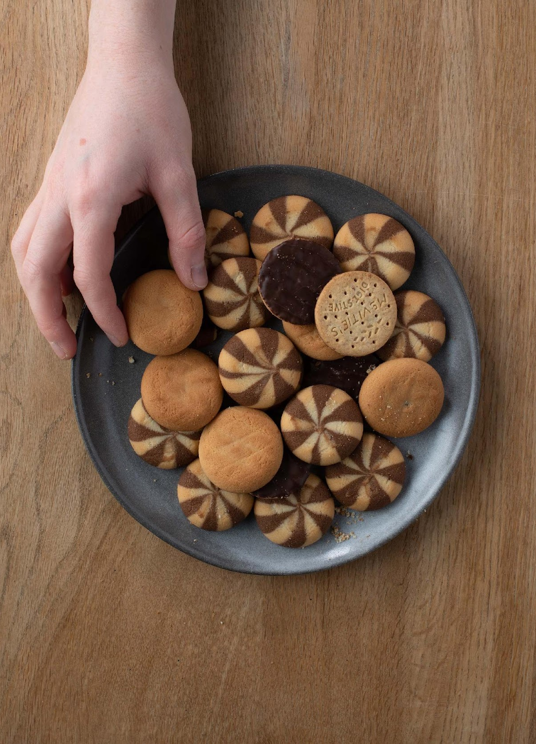
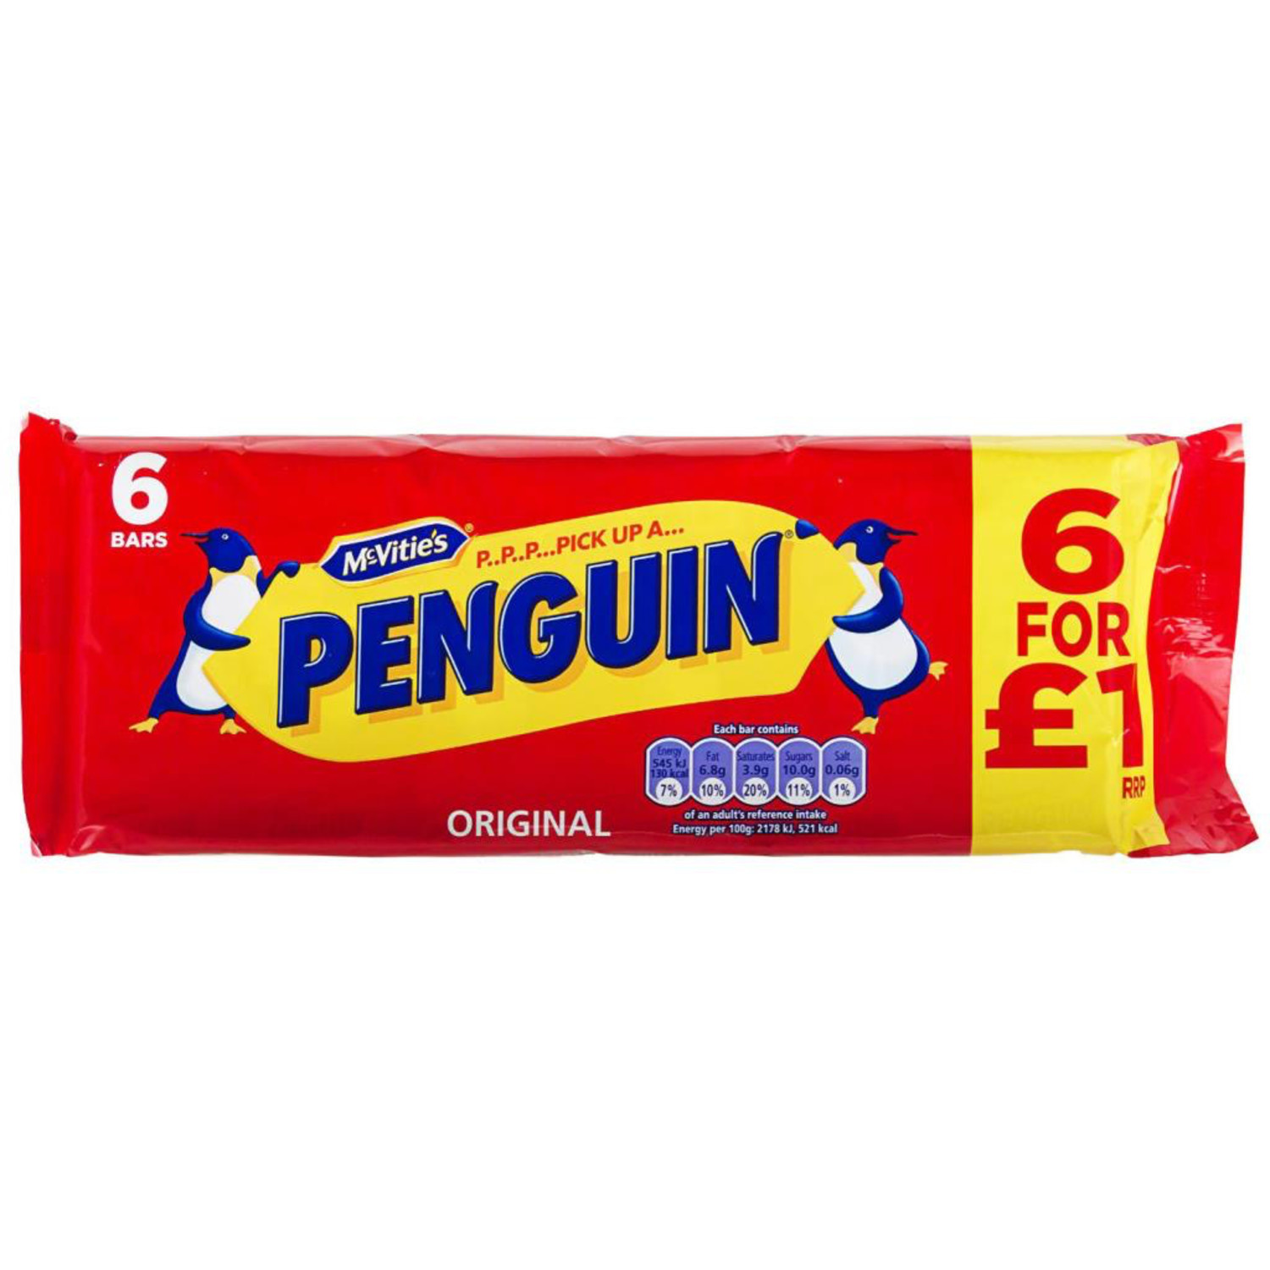
What makes it successful?
There is a lot of choice
There are different prices
They have lots of tasty biscuits
You can buy them everywhere

Slide 6
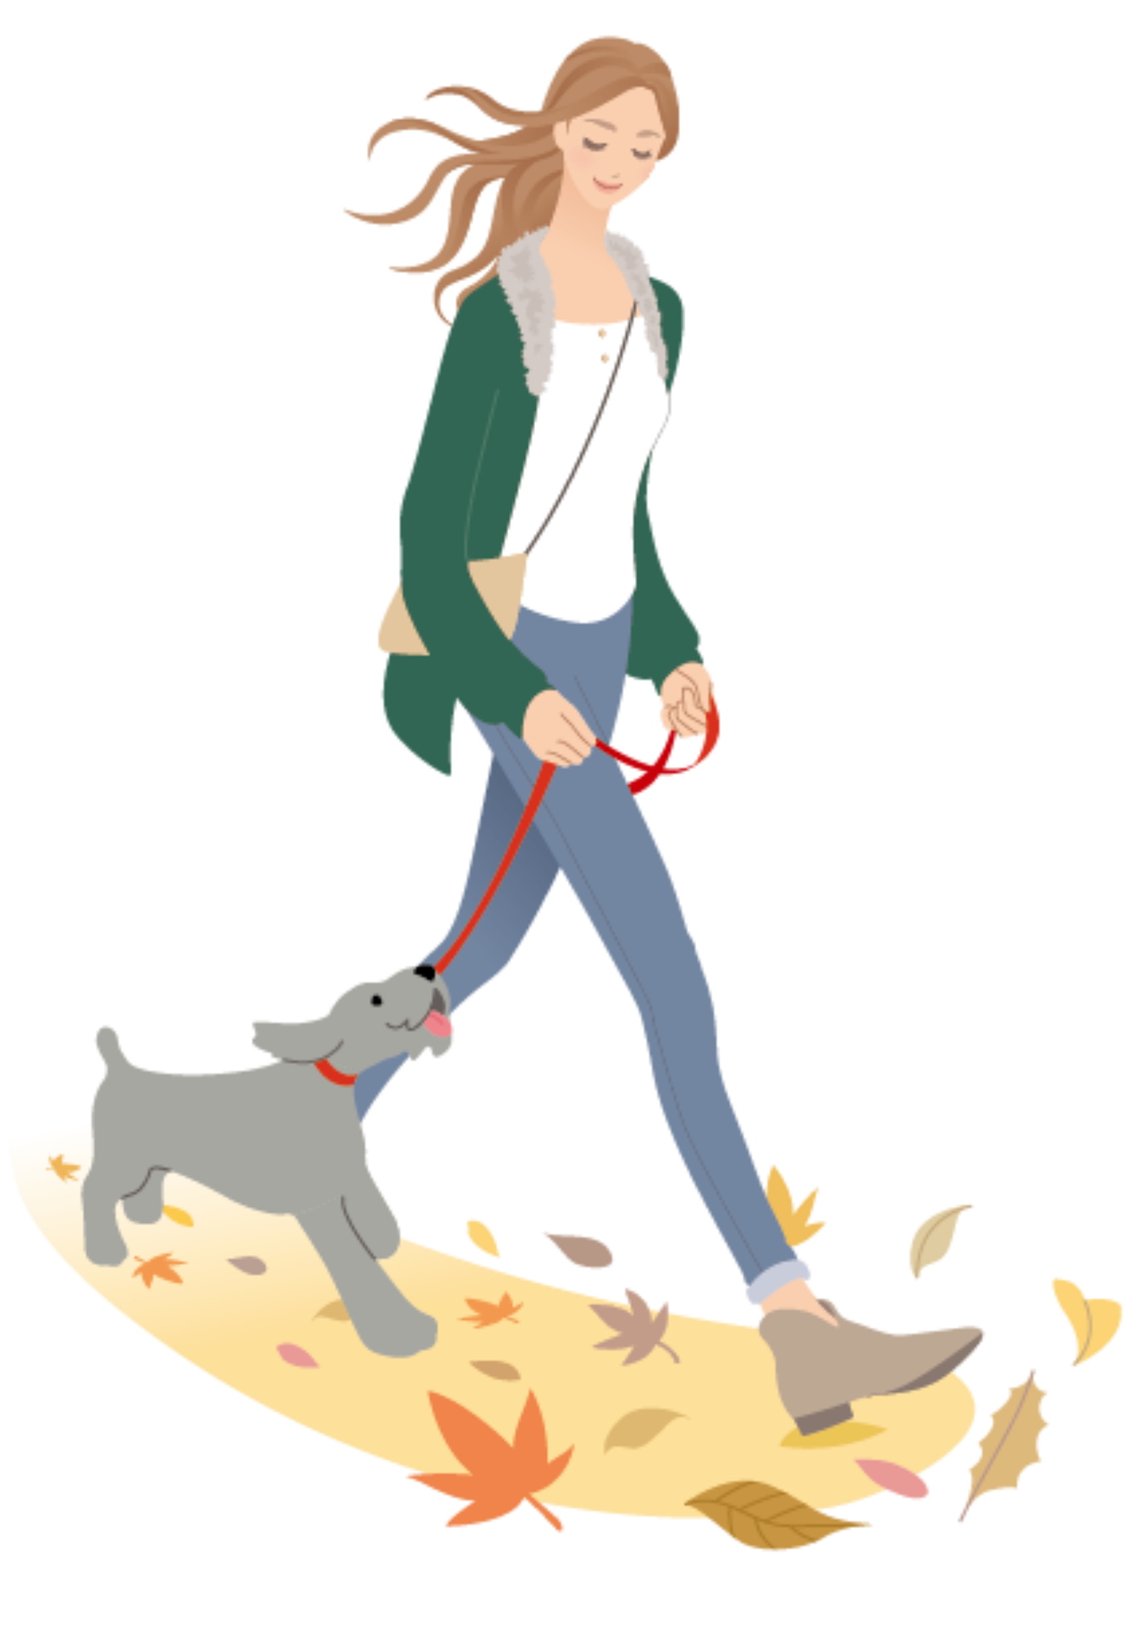
Is this a small, medium or large business?
Walkies – dog walker & sitter

Slide 7
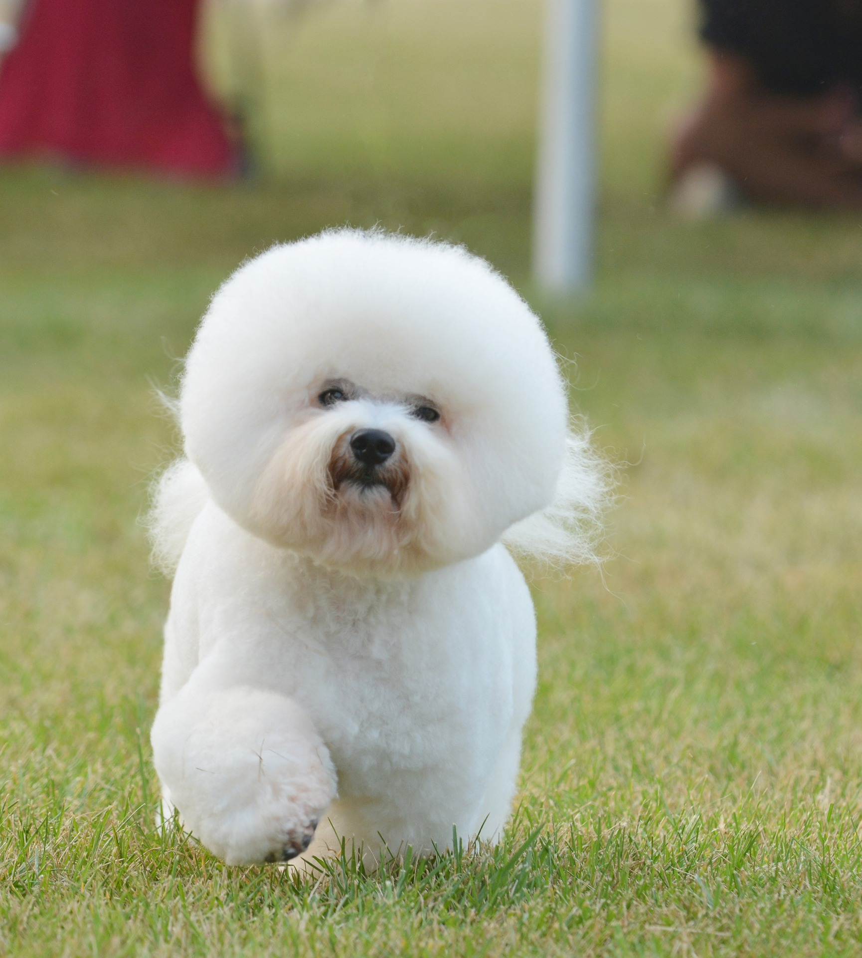
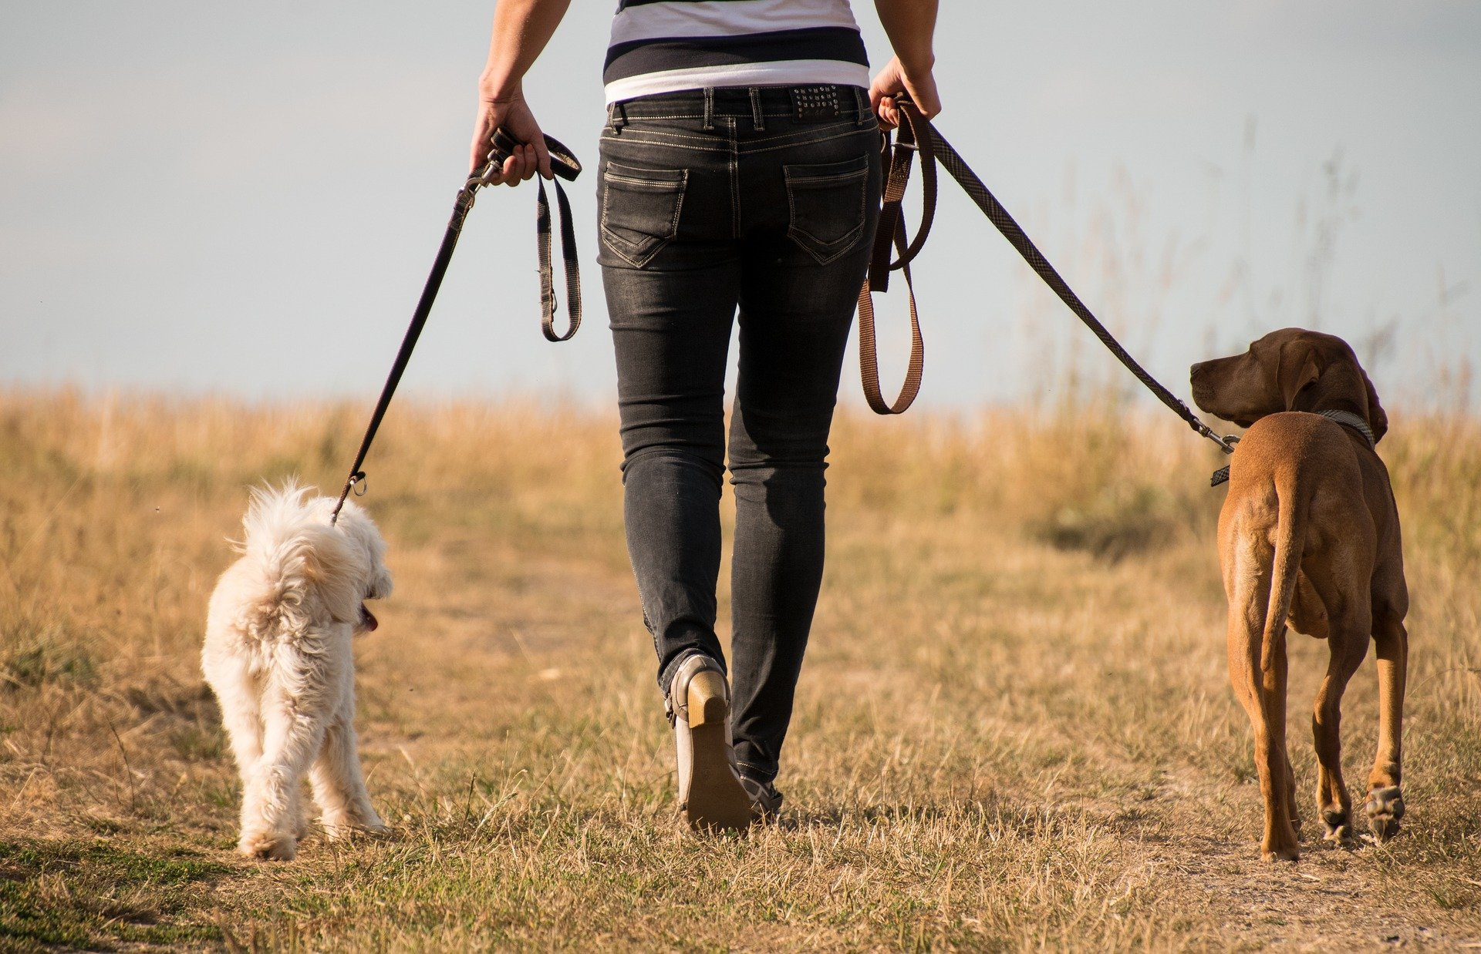
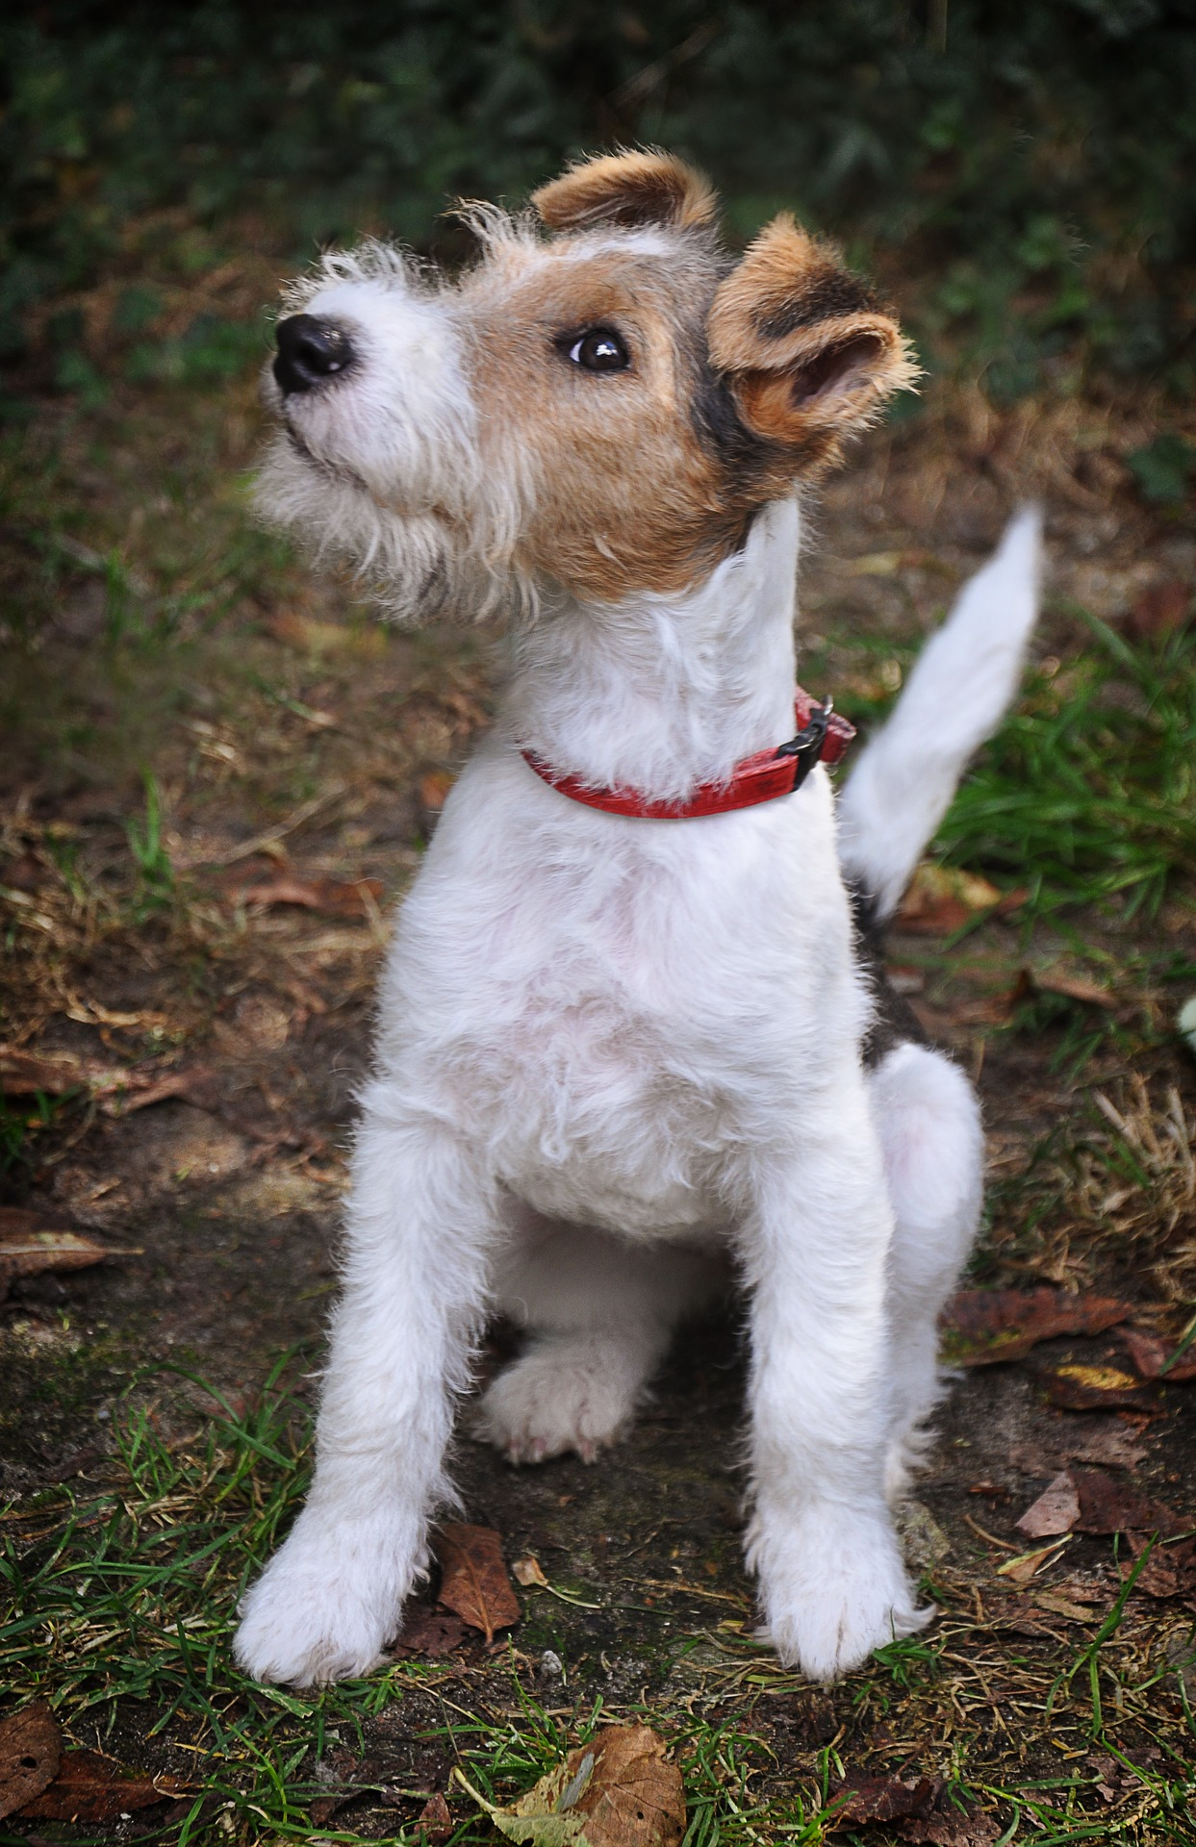
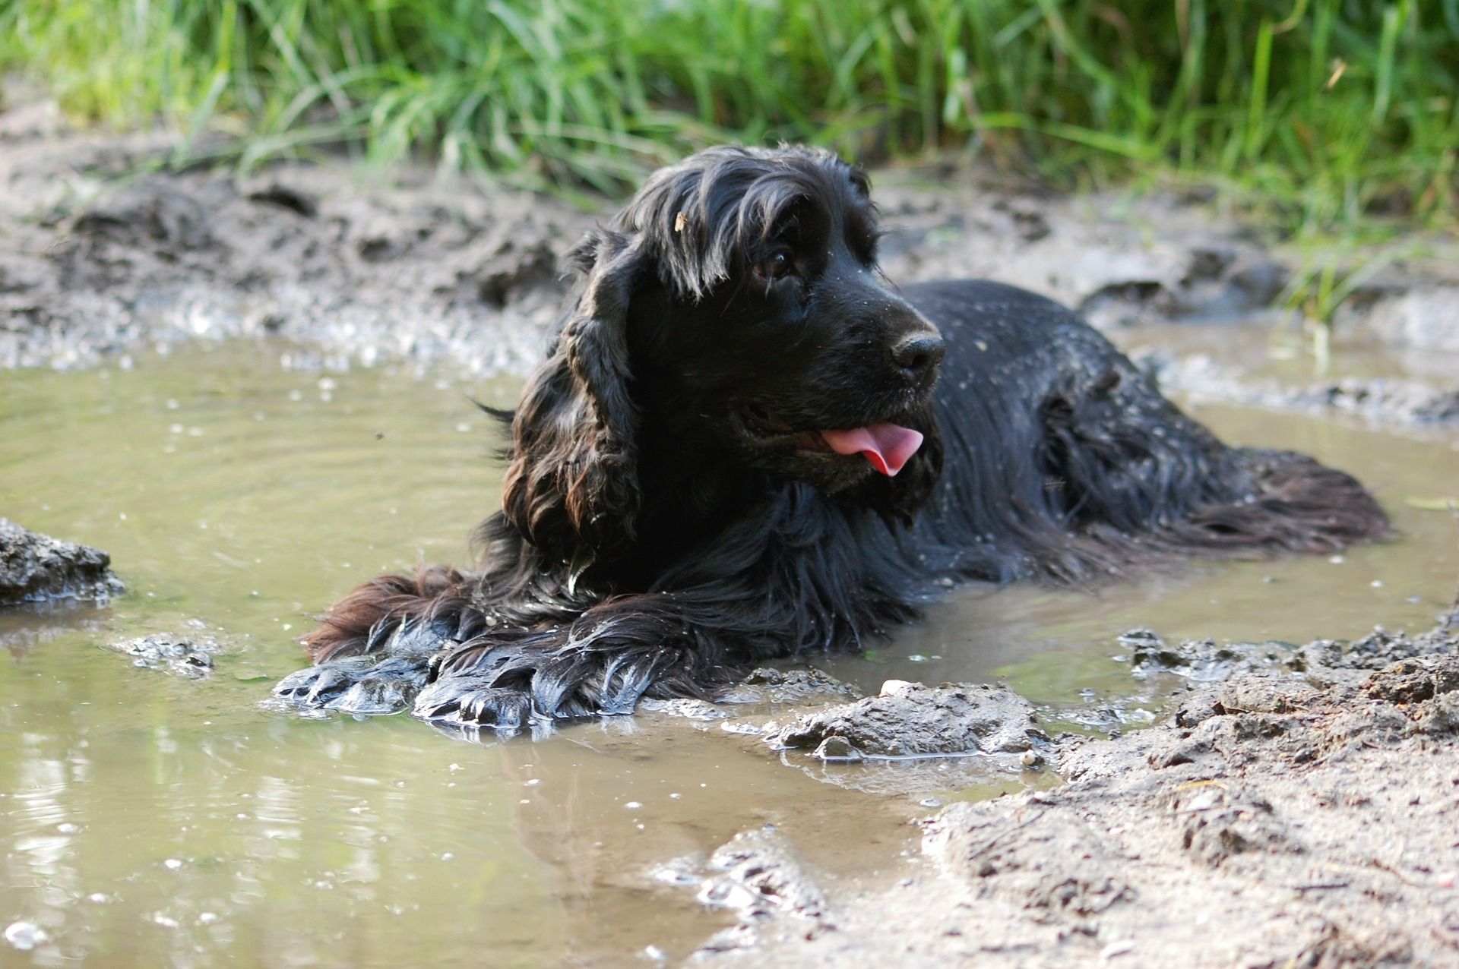
Does it provide goods or services?

Slide 8
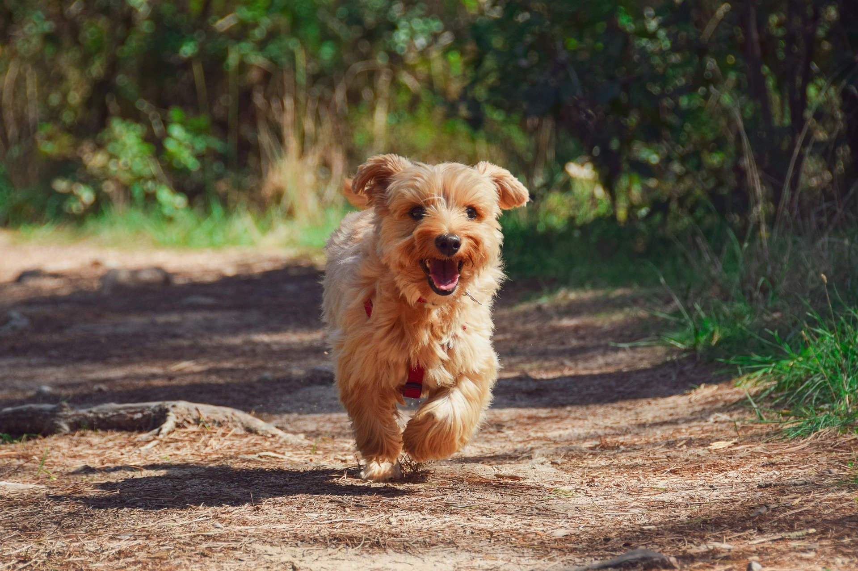
What makes it successful?
Lots of people have dogs
It’s flexible
It offers different options to suit
Keeps dog fit, healthy and happy

Slide 9
Useful video clip
What is a company – Happy Learning - https://youtu.be/EX9CgUTsTUg

