Slide 1




In today’s task, you will form your own business.
You will work as a team competing alongside other businesses.
You will only succeed if you collaborate and trade with other businesses.
Activity
developed by

Slide 2


Who likes Maths?
Can you name any jobs that need you to use maths?

Slide 3
Some keywords
Business
Industry
Trade
Collaborate

Slide 4
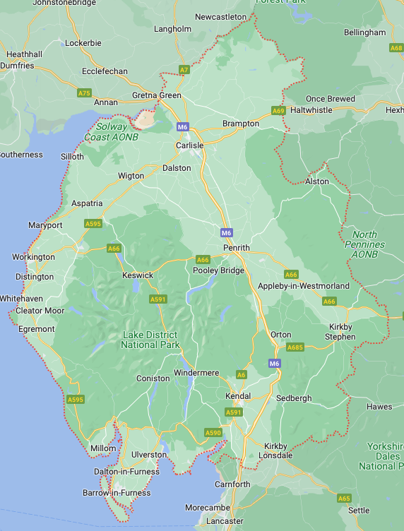
Types of industry in Cumbria
Think of different businesses
Think of different types of job

Slide 5

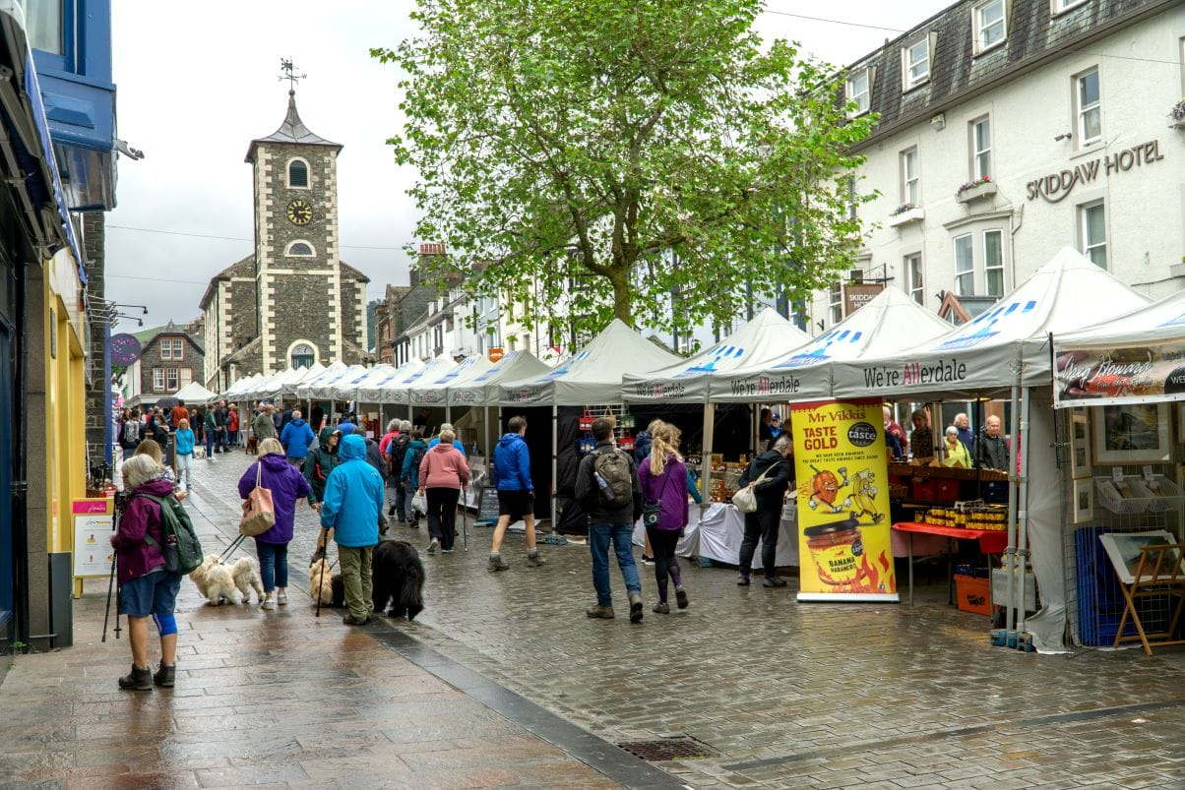
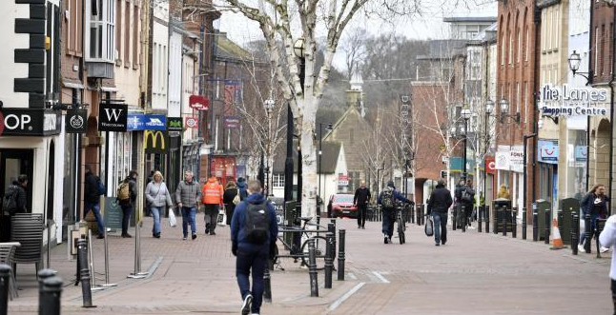
Commercial:
Shops
Banks
Office work
Practical trades

Slide 6
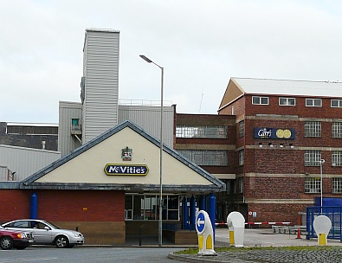
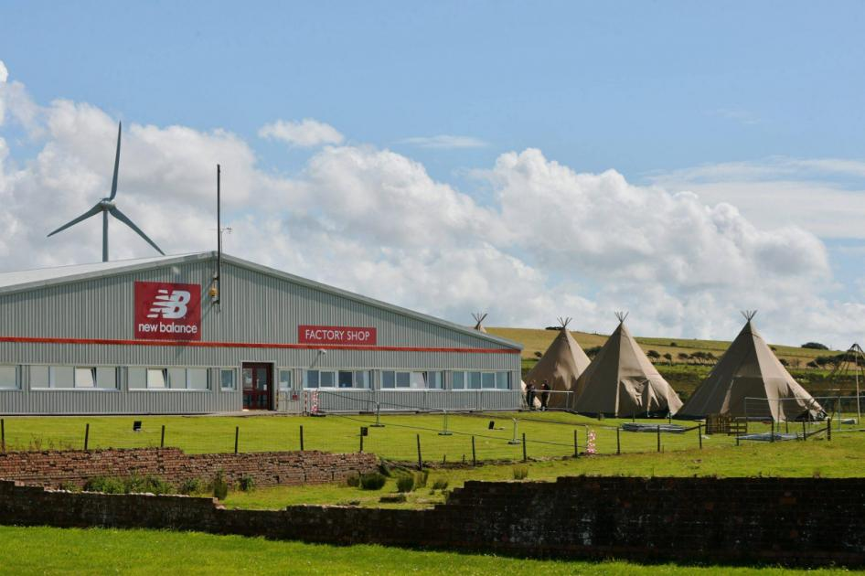
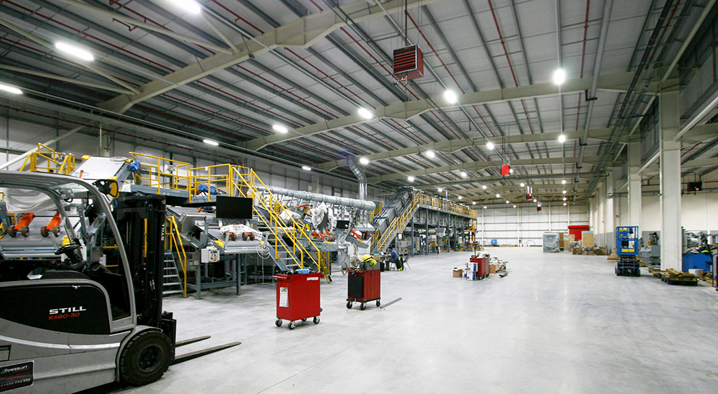
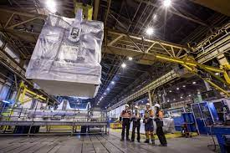
Manufacturing:
(Making things)

Slide 7
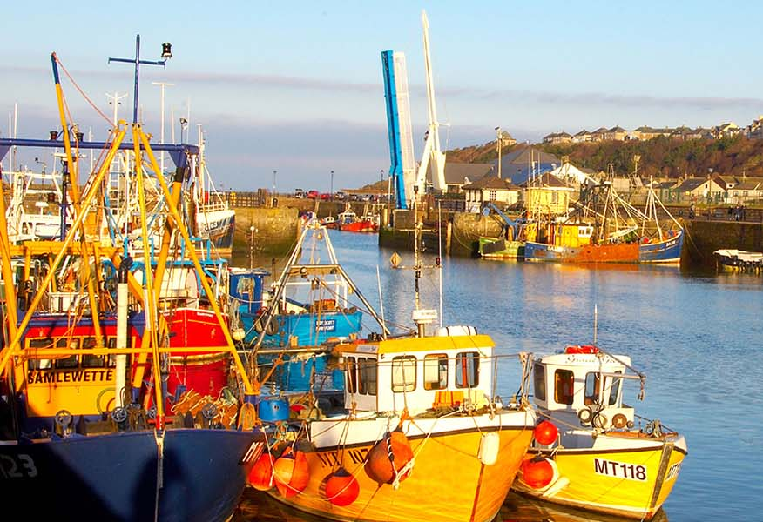
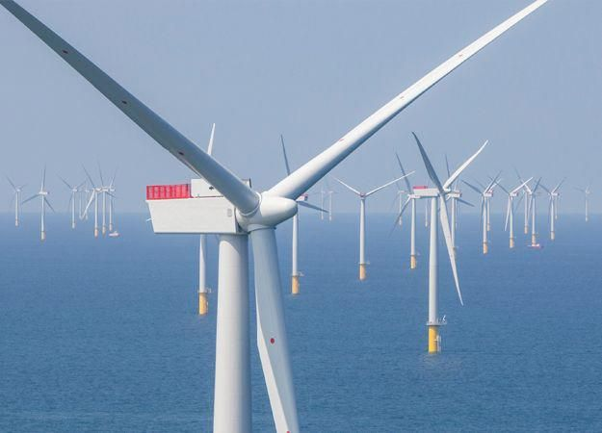

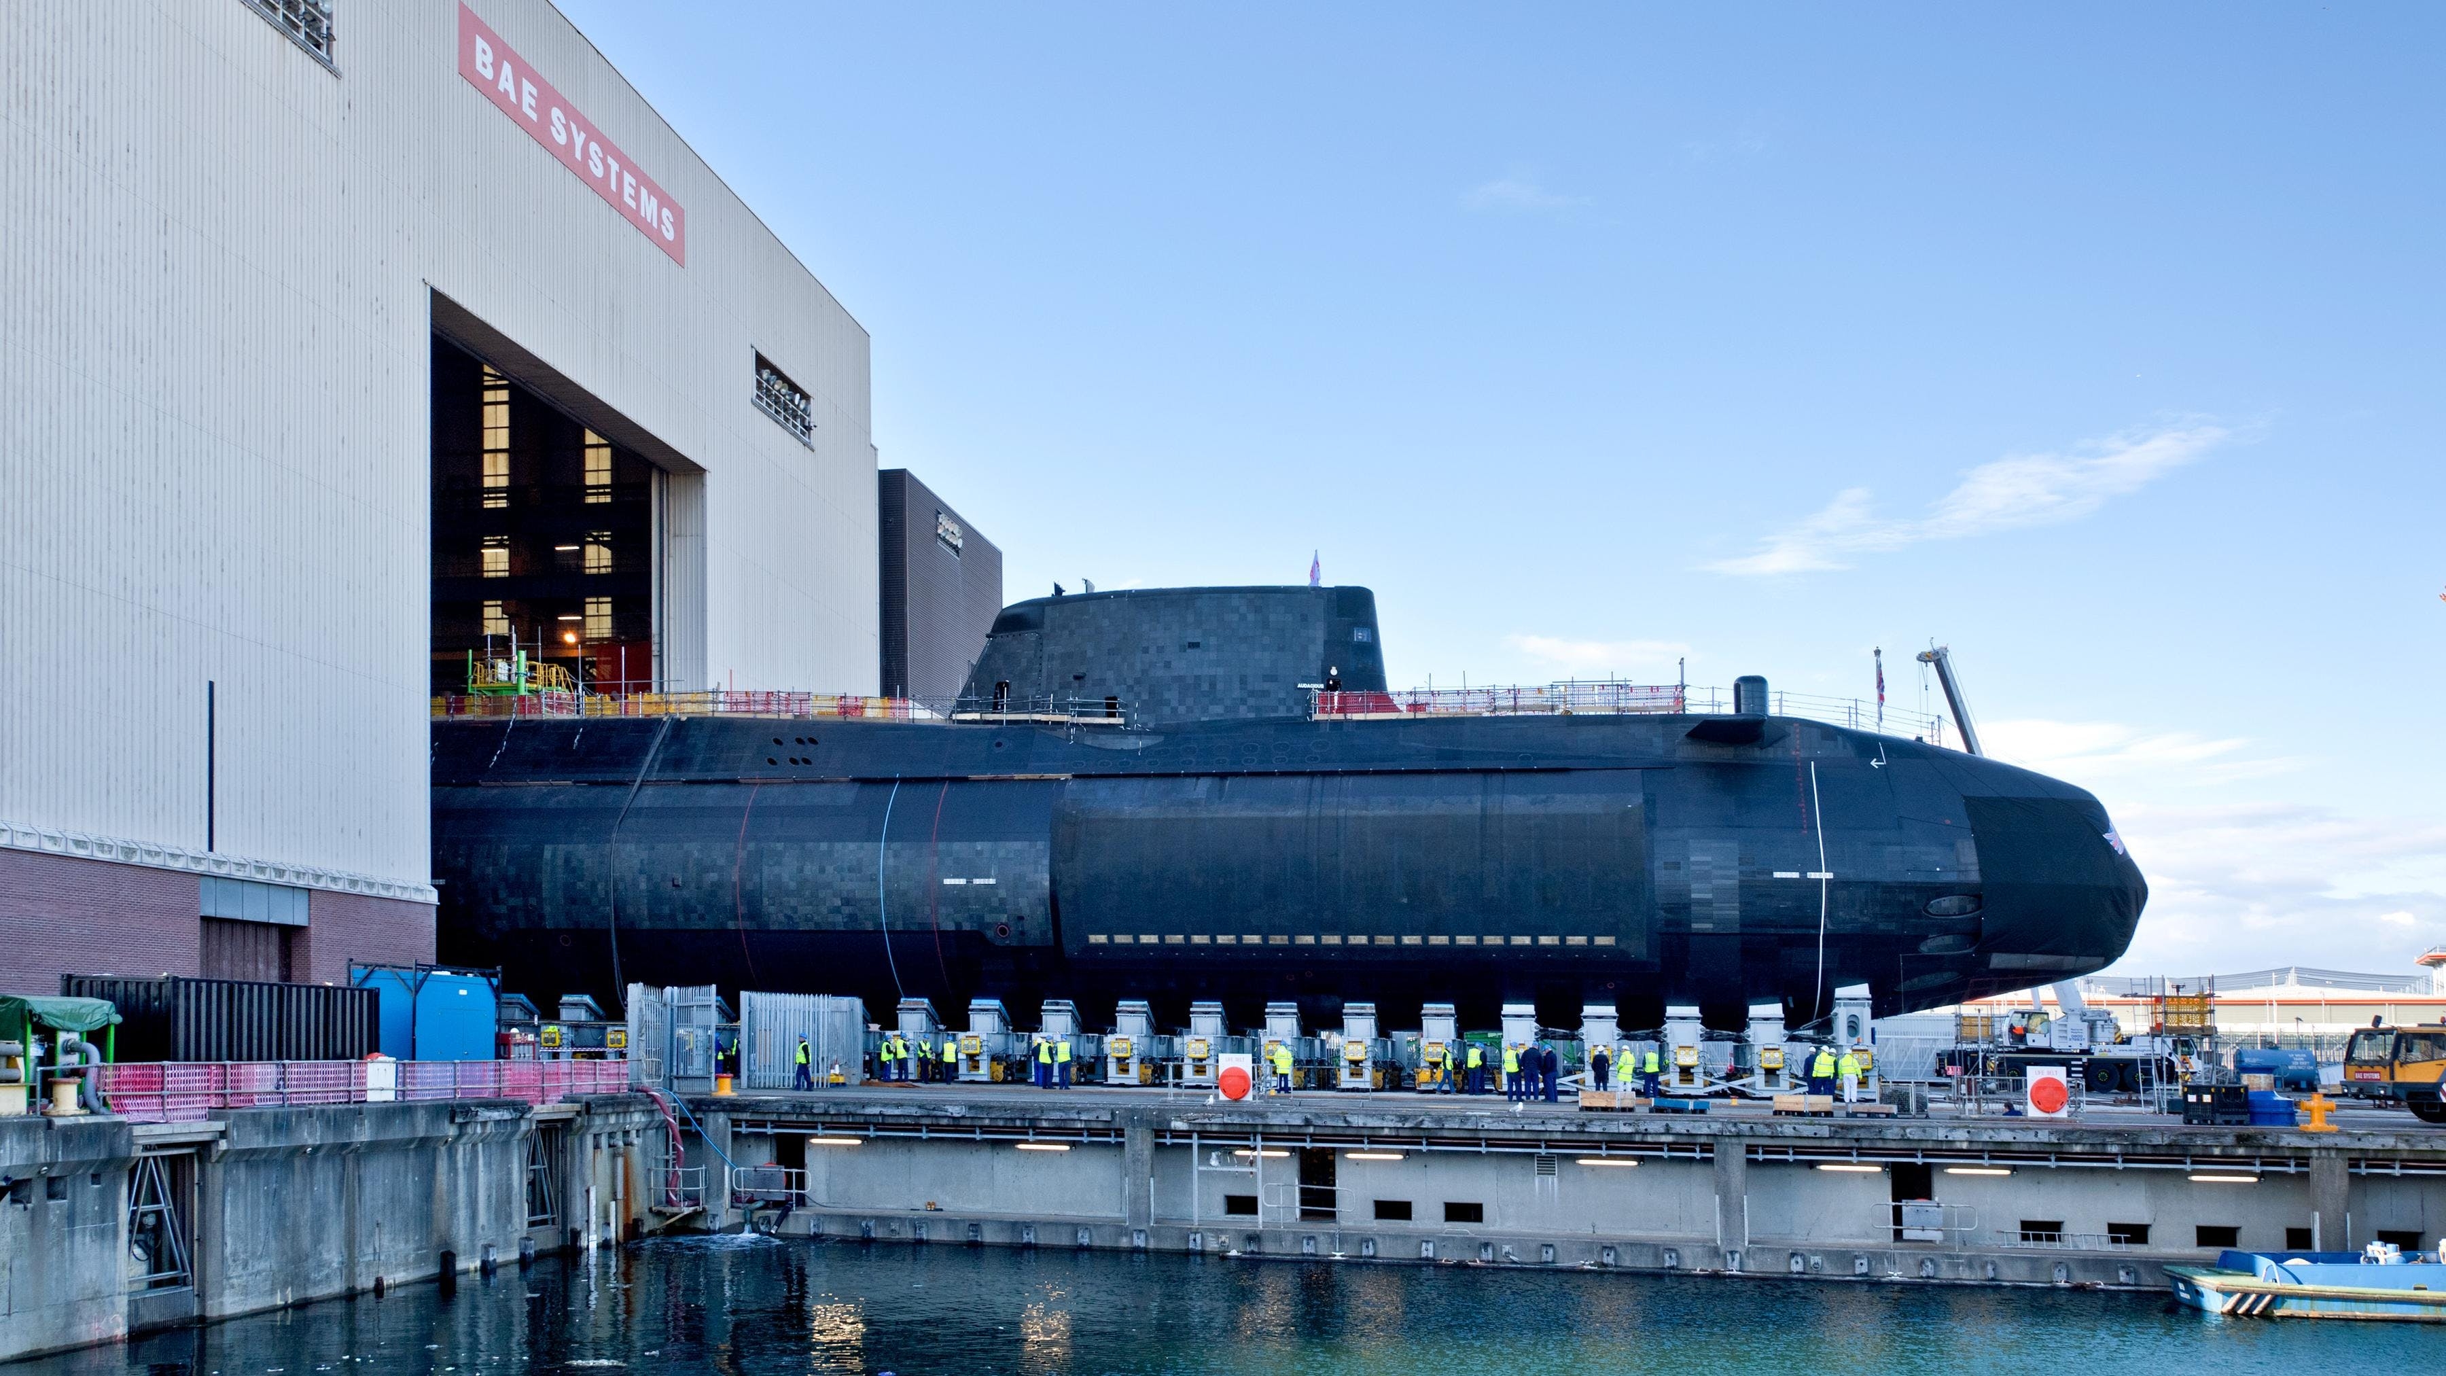
Cumbria has
lots of water!

Slide 8
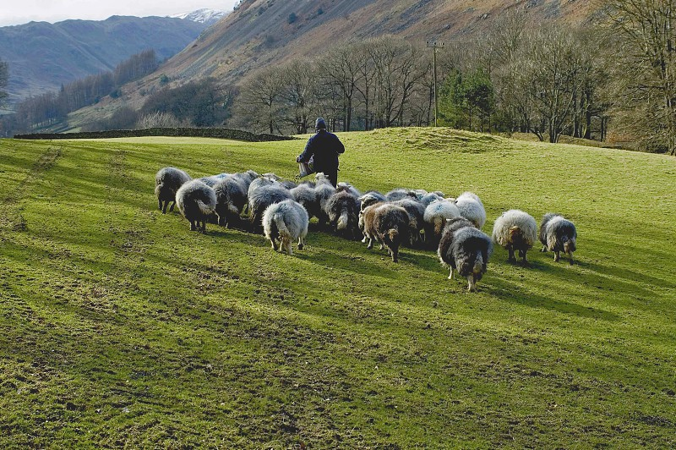
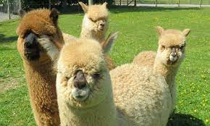
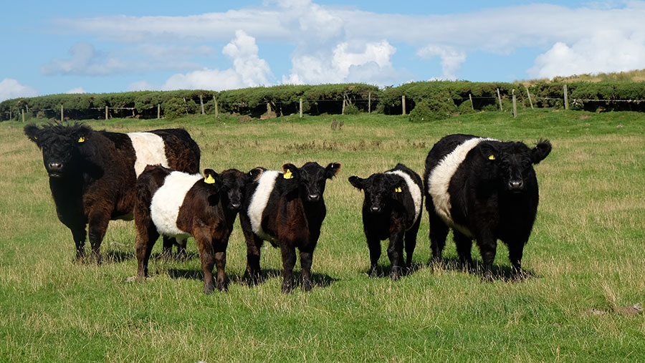
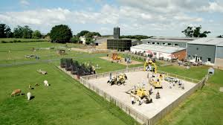
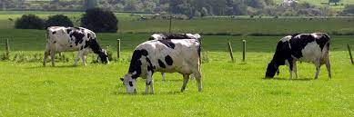
Agriculture
(Farming)

Slide 9
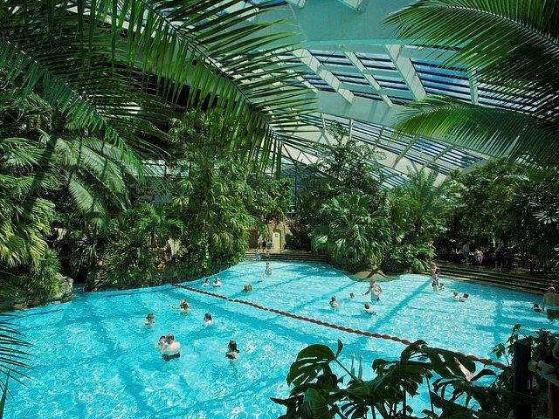
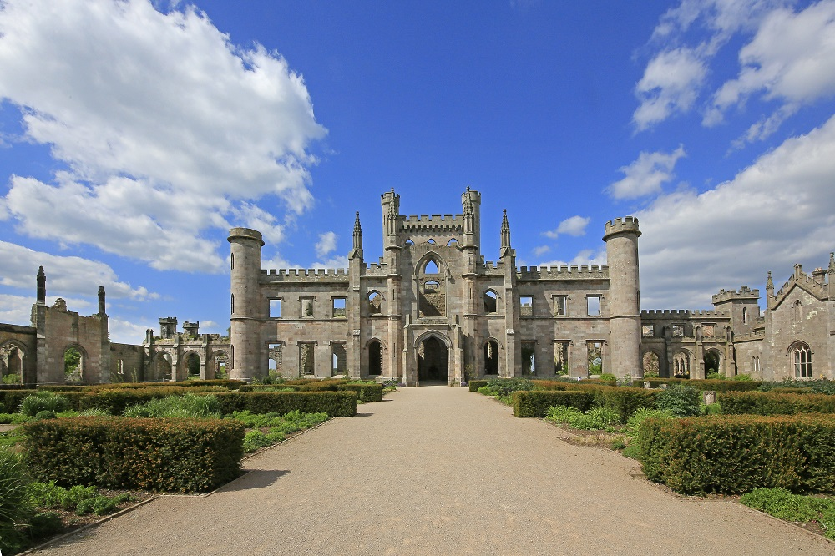
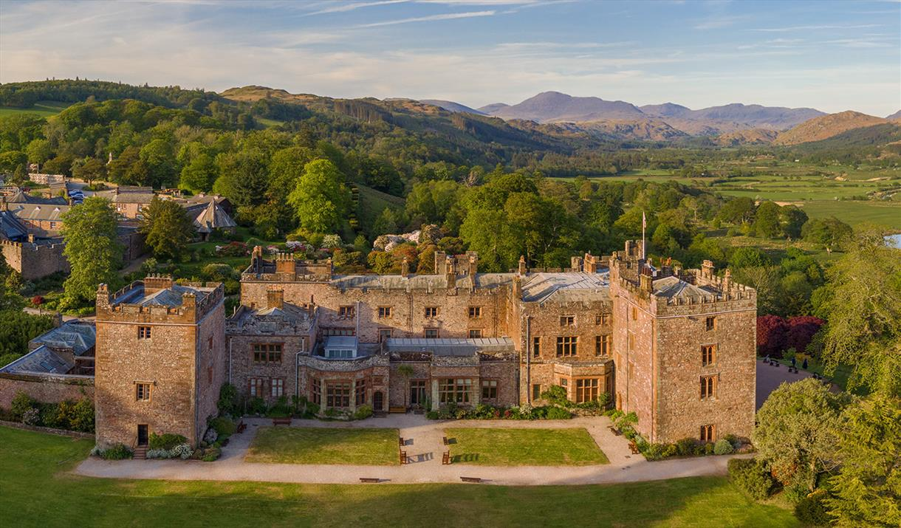
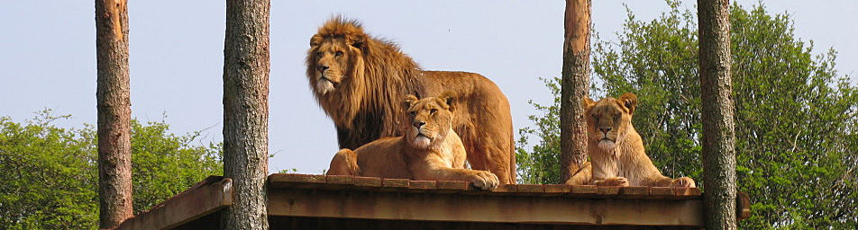
Tourism
Notes:
Answers:
Center Parcs,
Lowther Castle
Muncaster Castle
Safari Zoo

Slide 10
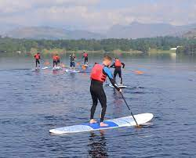
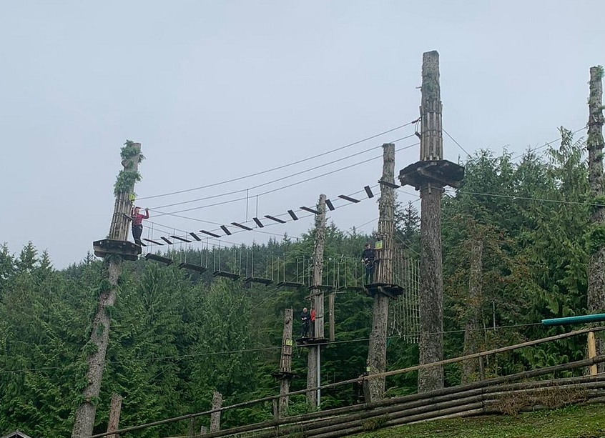
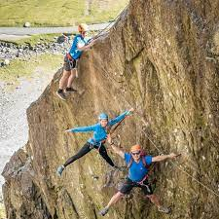
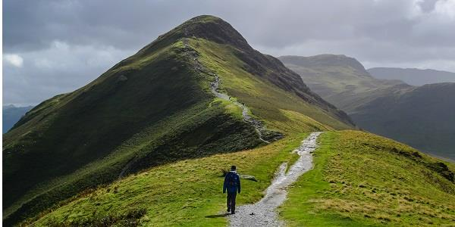
Outdoor
Tourism

Slide 11
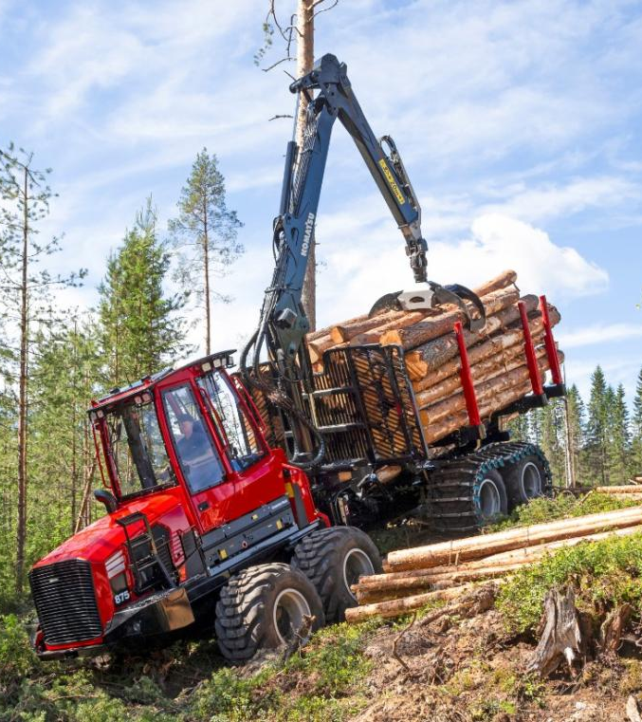
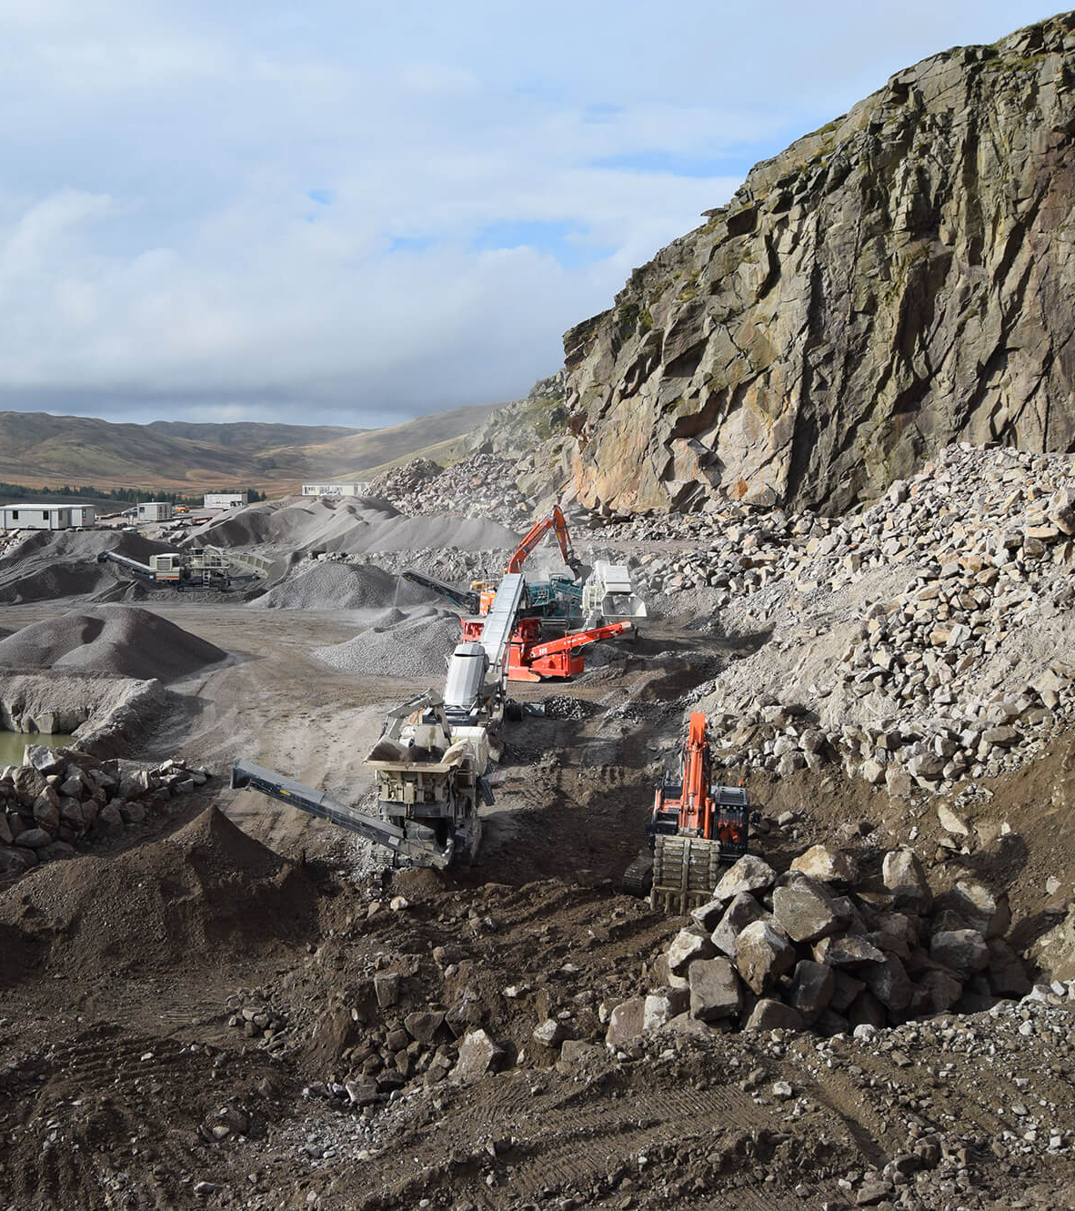
Forestry Quarry

Slide 12
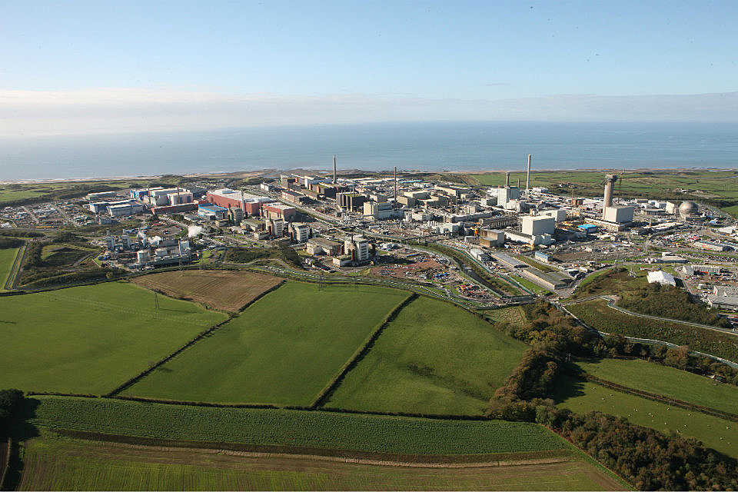
Sellafield

Slide 13
Our Cumbria Traders Game
Objective:
Build models that represent industry in Cumbria.
You will get money for each model you build.
You will have chance to buy and trade bricks.
Unlock better designs and higher rewards.
FIRST STEP:
Review the designs in the construction guide and the industrial awards booklet.

Slide 14
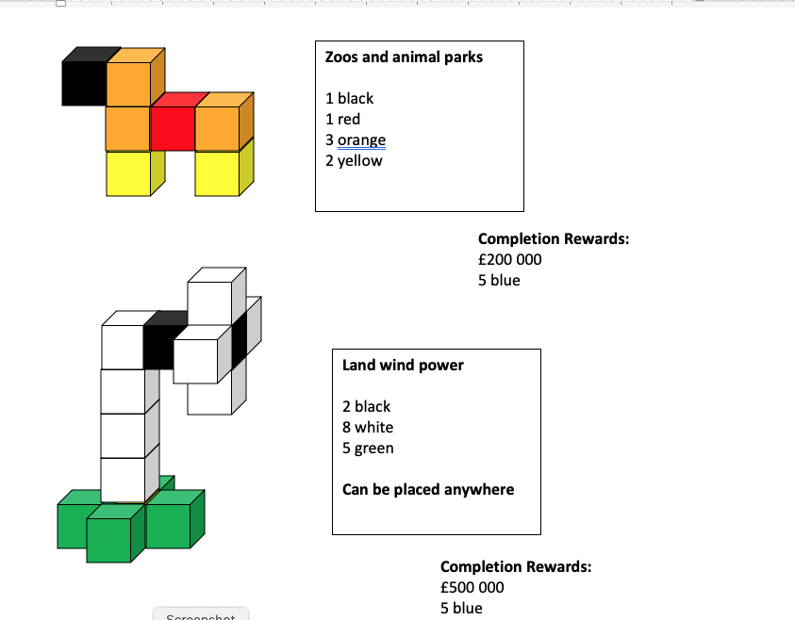
Example
There are only limited spaces for most items on the map.
Keep an eye out…
No space, no sale!
There can be an unlimited amount of some other items.
This is indicated by the fact they
“can be placed anywhere”.

Slide 15
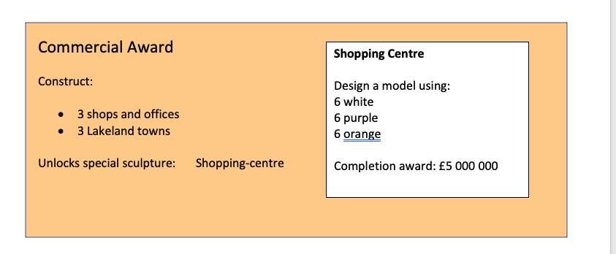
Example – industrial awards
Only one team can win each award – but you can win more than one

Slide 16
The 4 phases of play:
Plan
Trade
- up two people from each team may act as trade delegates
they may trade / buy bricks from other teams.
- another person may buy bricks from the bank from level 2 onwards.
The bank prices will go up every ten minutes!
Build
Place on map and sell

Slide 17
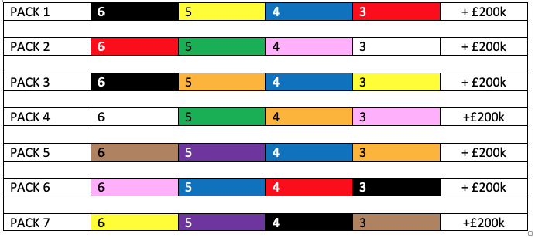
Planning Phase 1
Choose your business name
Choose your starting pack

Slide 18


TRADE / BUILD / SELL Level 1
- up two people from each team may act as trade delegates
they may trade / buy bricks from other teams.
The bank is currently CLOSED for 5 minutes

Slide 19

TRADE / BUILD / SELL Level 2 - 10 minutes
- up two people from each team may act as trade delegates
they may trade / buy bricks from other teams.
- another person may buy bricks from the bank.
Current bank Prices:
5 bricks of your choice (any one colour) £200 k
1 brick of every colour £100 k

Slide 20
TRADE / BUILD / SELL Level 2
- up two people from each team may act as trade delegates
they may trade / buy bricks from other teams.
The bank is currently CLOSED for 5 minutes
Next Prices:
£400 k
£200 k

Slide 21
TRADE / BUILD / SELL Level 3 – 10 minutes
- up two people from each team may act as trade delegates
they may trade / buy bricks from other teams.
- another person may buy bricks from the bank.
Current bank Prices:
5 bricks of your choice (any one colour) £400 k
1 brick of every colour £200 k

Slide 22
TRADE / BUILD / SELL Level 3
- up two people from each team may act as trade delegates
they may trade / buy bricks from other teams.
The bank is currently CLOSED for 5 minutes
Next Prices:
£800 k
£400 k

Slide 23
TRADE / BUILD / SELL SELL Level 4 – 10 minutes
- up two people from each team may act as trade delegates
they may trade / buy bricks from other teams.
- another person may buy bricks from the bank.
Current bank Prices:
5 bricks of your choice (any one colour) £800 k
1 brick of every colour £400 k

Slide 24
TRADE / BUILD / SELL Level 4
- up two people from each team may act as trade delegates
they may trade / buy bricks from other teams.
The bank is currently CLOSED for 5 minutes
Next Prices:
£1.6 M
£800 k

Slide 25
TRADE / BUILD / SELL SELL Level 5 – 10 minutes
- up two people from each team may act as trade delegates
they may trade / buy bricks from other teams.
- another person may buy bricks from the bank.
Current bank Prices:
5 bricks of your choice (any one colour) £1.6 M
1 brick of every colour £800 k

Slide 26
TRADE / BUILD / SELL Level 5
- up two people from each team may act as trade delegates
they may trade / buy bricks from other teams.
The bank is currently CLOSED for 5 minutes
Next Prices:
£3.2 M
£1.6 M

Slide 27
TRADE / BUILD / SELL Level 6 – Final Level
- up two people from each team may act as trade delegates
they may trade / buy bricks from other teams.
- another person may buy bricks from the bank.
Current bank Prices:
5 bricks of your choice (any one colour) £3.2 M
1 brick of every colour £1.6 M

Slide 28
TRADING IS NOW FINISHED!!
Count up your remaining money. The team with the most left is the winning team!

Slide 29
Evaluation… Why do we evaluate?
What skills did we demonstrate?
What did we find difficult?
What did we enjoy?
Did people in your team take different roles?
Notes:
Facilitator to add/remove questions as required.
Key skills shown…problem-solving, geometry, calculation, collaboration and team work?

