Slide 1




Slide 2
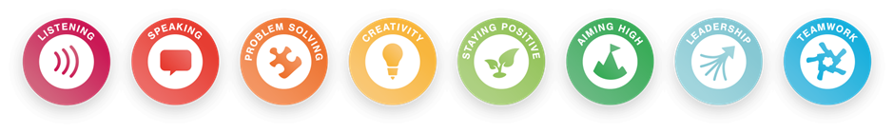
My Crest
Essential Skills Development:
7 7 3 7 6 6 7

Slide 3
My Crest
My Crest template:
Use crayons, pencils, coloured pens or pictures from magazines to design your Crest
Think about:
  What you like doing
  How you like to spend your time
  Are there any jobs that you think you would like to do in the future?
Get creative and have fun….

Slide 4
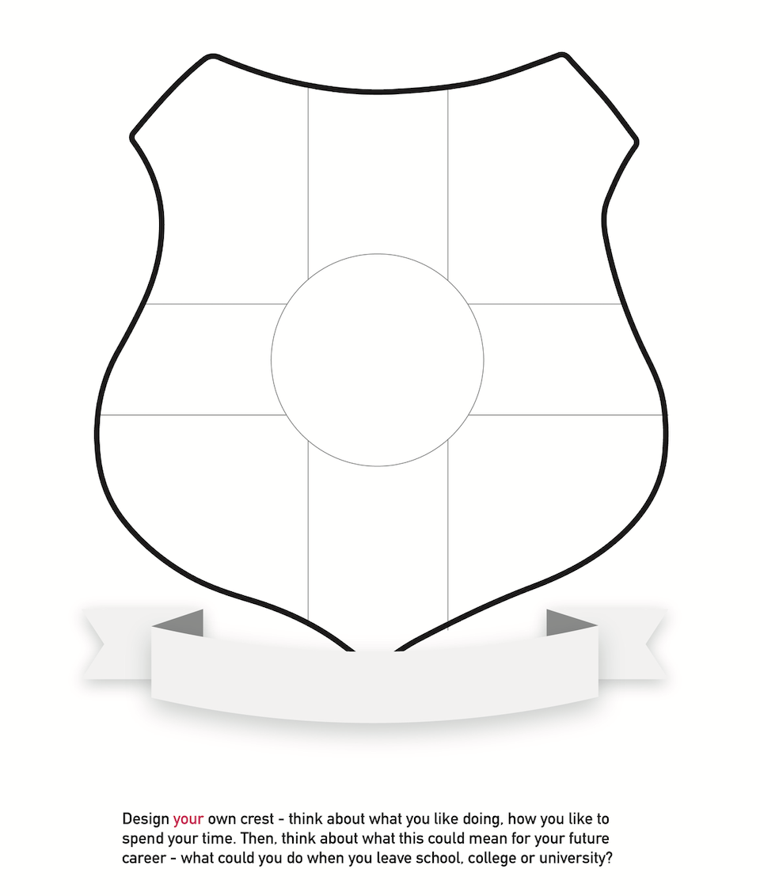
My Crest
Paint
Crayons
Glue
Collage
Decoupage

Slide 5




What could your My Crest be like?
Values
Emotions
Sports
Music
Hobbies
Books
Drama
Ambitions
Arts
Kindness
Science
Community
Friendships

Slide 6

Thank you
For more info:
Rebecca Day
E: Rebecca.Day@pbp.org.uk
M: 07814 881598
For more info:
Claire Johnson
E: Claire.johnson@pbp.org.uk
M: 07843 684746
primarybusinesspartnership.org.uk

