Slide 1



A FREE matchmaking and signposting service for primary schools and business across West Cumbria
COMPANY PLEDGE
Primary Business Partnership is funded by OneAIM and Sellafield Limited SiX – Social Impact Multiplied
The Centre for Leadership Performance are proud delivery partners
Notes:
Please substitute your own logo in the centre of the page, but keep the PBP and CfLP logos at the top left and right of every page

Slide 2
Notes:
Add appropriate images of your work place such as office , outdoor area, views of the building etc

Slide 3
Notes:
Add images of tools of your trade e.g. magnifying glass, pH water testing strip, computer screen shot with an example of the documents which you might use etc.

Slide 4
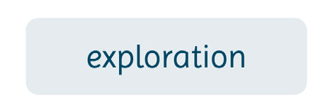
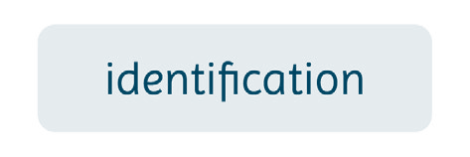
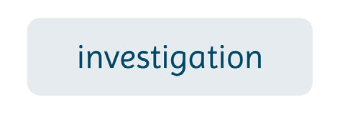
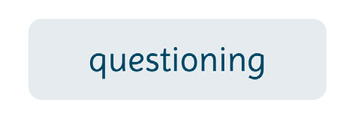
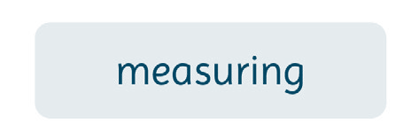
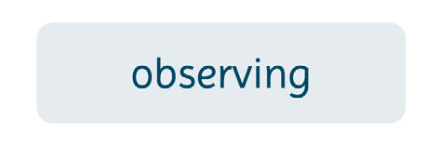
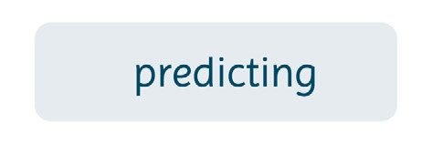
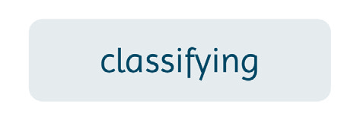
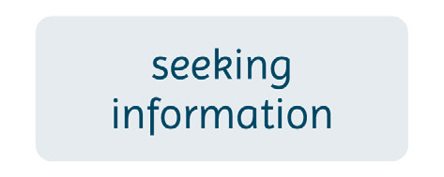
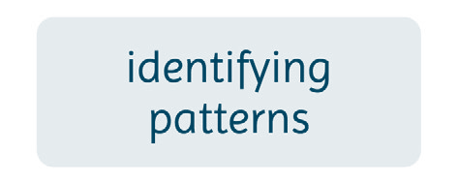
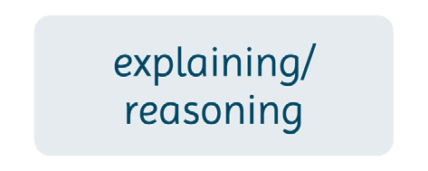
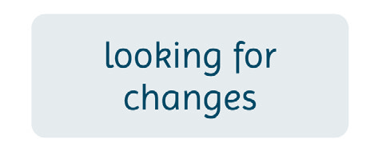
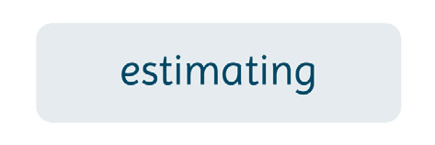


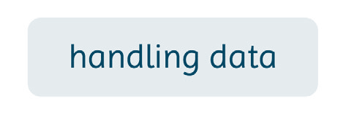
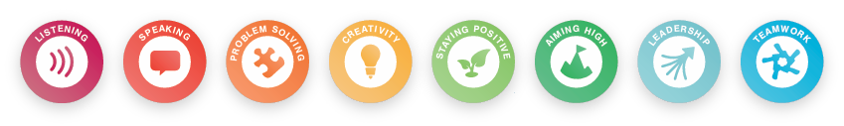
Notes:
Highlight the skills you use or delete those that you don’t use. (Double click on the box that you do not want and then delete). For each skill ask the children if they know what the word/ skill is and/or means. Let the children explain it in their own words and support them by possibly asking them to give examples of what and/or how they have used that skill in their school work, playing or at home.
If you can, add in the Skills Builder topics:
Listening
Speaking
Problem-solving
Creativity
Staying positive
Aiming high
Leadership
Teamwork

Slide 5
Notes:
Add photographs of your normal attire. If you work outside in the local environment maybe add a photograph of your wellingtons or waterproofs etc ,if you work in a lab a photo of your lab coat, goggles etc or if you work at a computer you could add everyday clothes or maybe decide to delete this slide.

Slide 6
Notes:
Do you work outside or in an office, does your work venue change depending on the aspect of your job for that particular day? Add in here any photos of your work venue.

Slide 7


Notes:
You might already have pre-empted this session by asking the teacher to prepare opportunities for the children to create questions beforehand, if this has not been done you may need to give the children examples of questions which allow for a yes or no example . E.g. “Where do you work ?” Will NOT allow a yes / no answer but a question “Do you work inside ?” Will allow a yes or no answer. Let them give you examples of their own ideas for questions which allow yes or no answers. You could base it on a photograph of an animal e.g a swan from a local river which you may be involved with the work on or a lake which is in the same village as the school etc. and have a child volunteer from the class answering with yes or no answers only.
You might decide to have a competitive element to this (especially if there are a few of you at the school talking about your roles/ careers) by putting the children in teams and each team taking it in turn to ask a question and the team who asks the most informative question winning a point/ pom pom or team point , whichever is most relevant, or who guesses your actual role title etc.
You might decide that you answer their questions then they go away in their groups and create on paper an idea of what your role involves , they may sketch an outdoor area with a digger present and lots of detailed drawings with accurate measurements if you are an engineer for example.

Slide 8

Notes:
Add a series of photographs or short video clips or snippets of your daily work life.
Depending on how the children are developing their ideas of what you do ,you may decide not to show them this until the end of the session when they have actually worked out what your role is.

Slide 9

Notes:
This is an opportunity for the children to volunteer their ideas with reasoning and justifications for that suggestion , not random guesses. This will allow you to discuss with the children a variety of roles/ careers which they may suggest. It would be prudent to have a general overview of other roles within EA so that you can suggest where the pupil’s ideas and suggestions might be seen or used in other EA work.
Roles within EA are hugely varied but include :
Fisheries, biodiversity and geomorphology specialists, flood and coastal risk management advisors, civil engineers with expertise in river catchments, coastal, reservoirs ,mechanical and electrical engineers , asset managers, environmental officers , water management officers, regulated industry advisors , ecologists , modellers , marine, fresh water and terrestrial monitoring team member, scientific laboratory staff; chemists, hydrologists, geomorphologists and many more such as HR, communication, lawyers, administration , finance and IT specialists.

Slide 10
Notes:
Show a video of your job role or describe it. Remember this is an opportunity to inspire these children and give them someone – you- to aspire to be like with your skills , attributes and enthusiasm for a role and career , giving them greater aspirations for their future.
Talk about not only your job and what it entails but also the impact that the subjects at school such as science , geography and maths had on your career and how important they are now in your role/career.
It may be that you are doing practical sessions with the class as well as talking about your job such as some of the other Environment Agency STEM Ambassador activities. Or maybe you can take with you a range of resources which you use in your role and set up a rotating set of activities for the children to take part in (often referred to as round robin activities in primary schools).
If so, discuss this with the teacher before hand with regards to risk assessment / health and safety procedures. In addition find out the numbers in the class and the organisation of the class in order for such sessions to take place with ease. You may also want to discuss with the teacher what resources you could access at the school such as measuring cylinders, sinks etc

Slide 11
Your closing slide
Notes:
Please substitute your own text if you like

