Slide 1




Slide 2

Who does this?
Essential skills development
7 7 7 7 6 6 5 7

Slide 3
Who does this?
Do you know what you want to be when you grow up?
Why do you want to be a …….?
What skills do you think you’ll need?

Slide 4
Who does this?
Now can you draw:
  a xxxxxxxx
  a xxxxxxxx
  a xxxxxxxx
  Insert job titles of the volunteers arranged for this session

Slide 5
Who does this?
Now let’s meet some volunteers……

Slide 6
Volunteer one….any photos to add to presentation

Slide 7
Who does this?
Questions to think about……Choose 3 to 4 points to discuss
Does anyone know what stereotype means?
A set idea that people have about someone or something is like, especially an idea that is wrong.
Do you think there are any limitations to what you want to be?
Why do you think there are limitations or obstacles to certain jobs?
What might some other obstacles be?
How do you think we can help?
Are there other jobs that you think are difficult to do as a result of stereotyping?
Why have you drawn this / that element?
Do you know someone who does this job, is that why?
Why did lots of people draw a man/woman?
Why is no one in a wheelchair?
Could men and women do this role?
Could someone who has a disability do this job?
How did you know about this job?
What type of skills would you need to be able to do this job?
How do people learn about different jobs and work?
Why do we need to break these obstacles down?

Slide 8
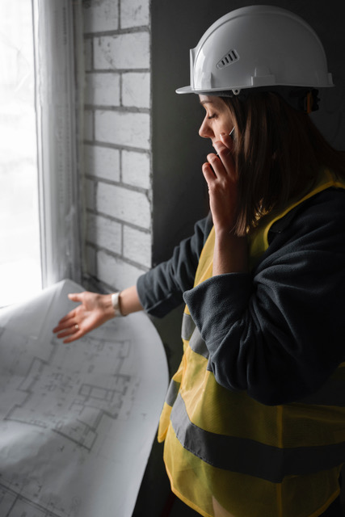
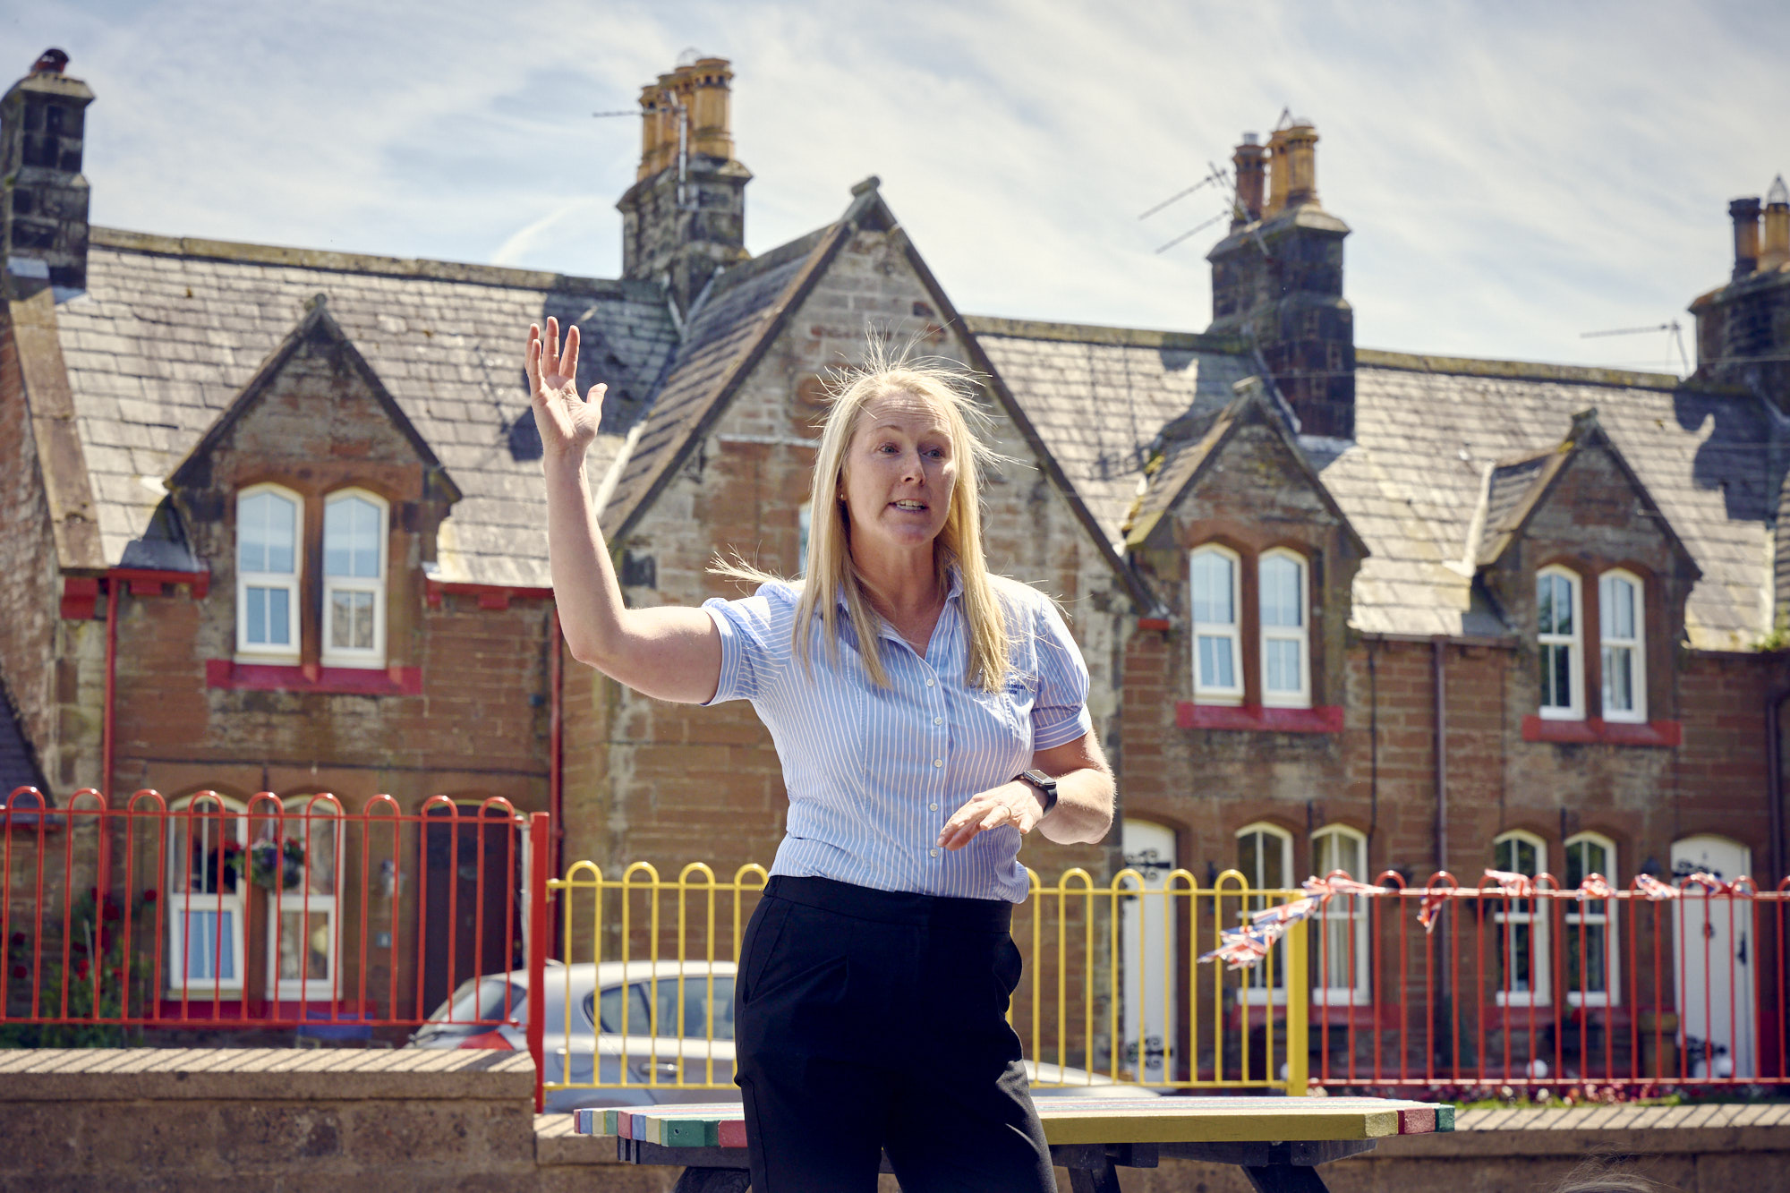
Who does this?
Have a look at other people who work……
Caroline Hamilton is a Mechanical Engineer and one of our volunteers
Engineers

Slide 9
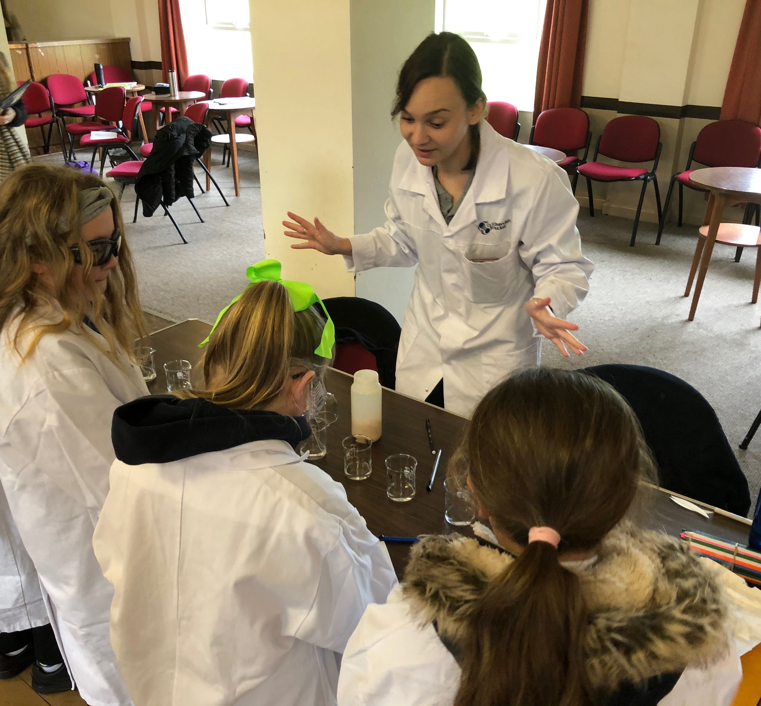
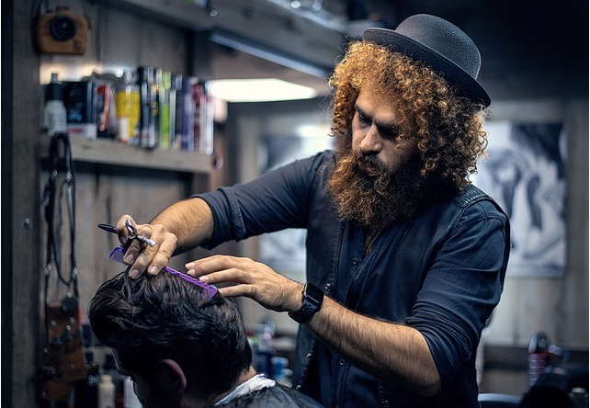
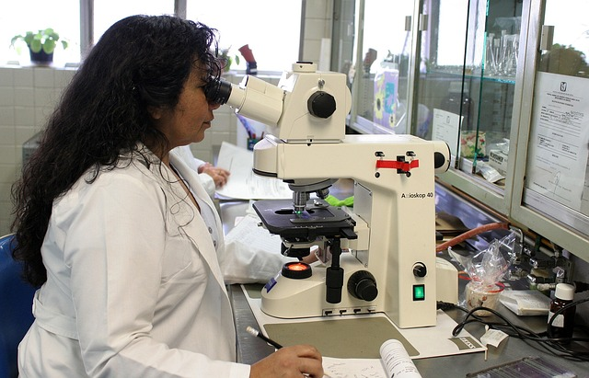
Who does this?
Scientist
Scientist
Hairdresser
Hairdresser

Slide 10

Who does this?
Nursing
A children’s book about male nurses, aimed at four to seven year olds. ‘My Daddy is a Nurse’ defies the assumption that all nurses are women by showcasing men working within the traditionally female-centric profession.

Slide 11
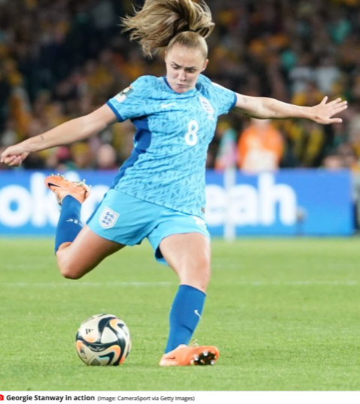
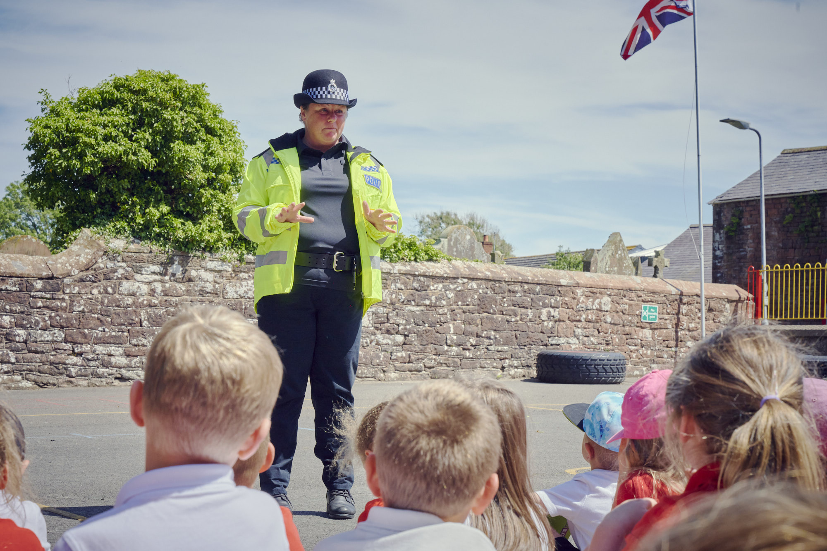
Who does this?
Alison St Quintin is a police officer and one of our volunteers
Police
Footballer
Police
Georgie Stanway, from Cumbria is an English professional footballer who plays as an attacking midfielder for Frauen-Bundesliga club Bayern Munich and the England national team. She played in 2023 World Cup in the Finals.

Slide 12
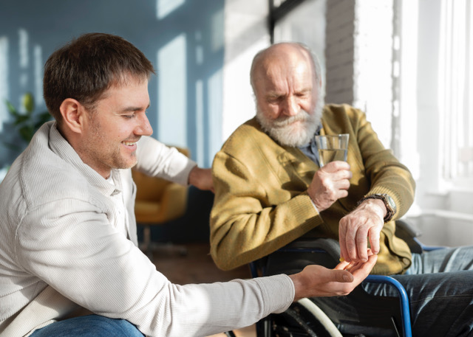
Who does this?
Carers
Police

Slide 13
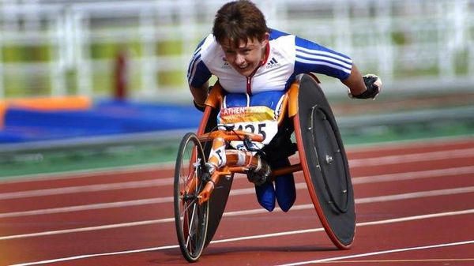
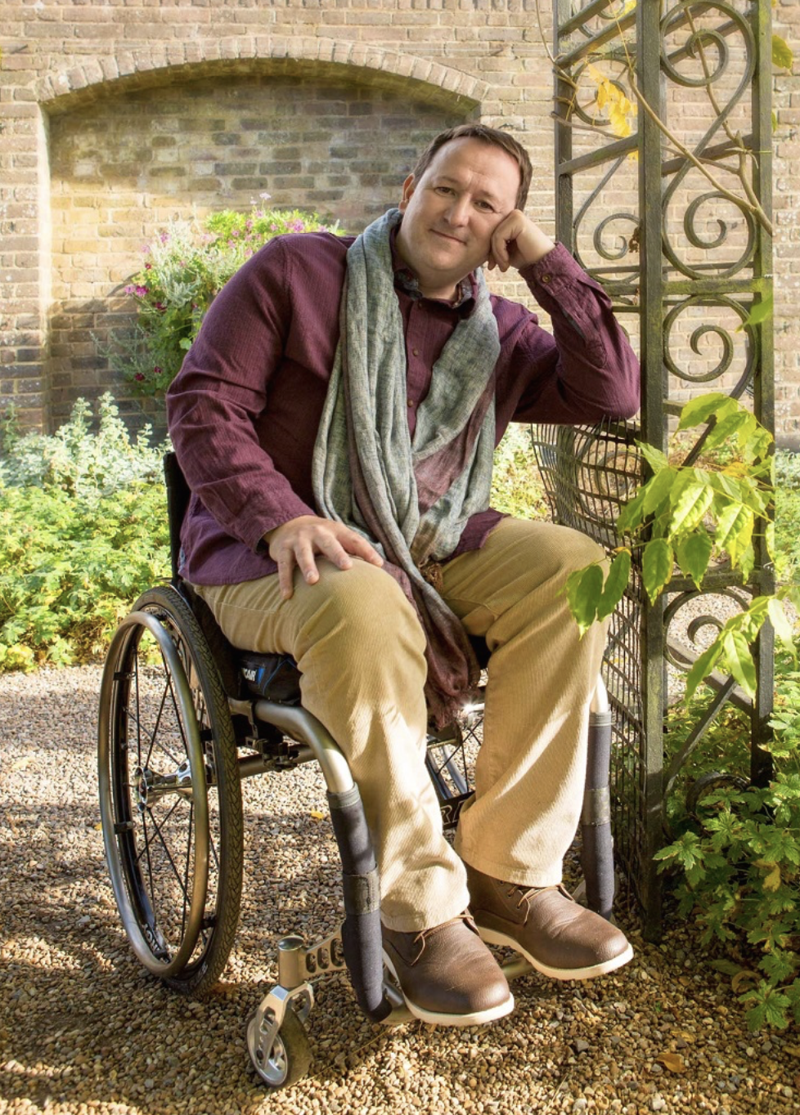

Who does this?
Tanni Grey-Thomson, Olympian,Baroness
and tv presenter
Mark Lane,
Gardener & presenter
on BBC
Steve Brown,
Presenter on Country File
Police

Slide 14
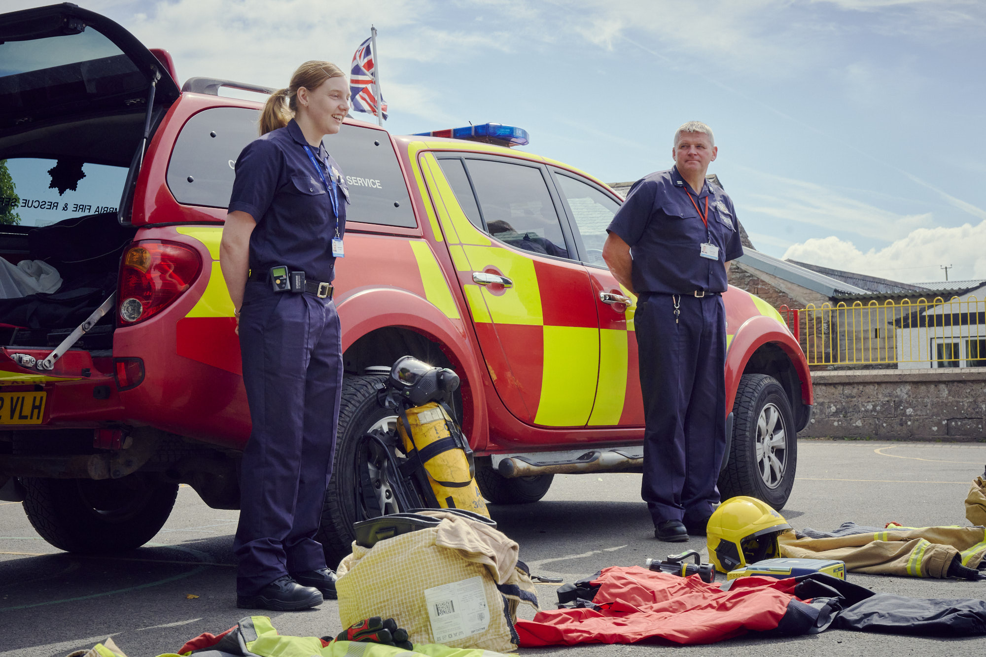
Who does this?
Firefighters
Police

Slide 15

Thank you
For more info:
Rebecca Day
E: Rebecca.Day@cforlp.org.uk
M: 07814 881598
For more info:
Claire Johnson
E: Claire.johnson@pbp.org.uk
M: 07843 684746
primarybusinesspartnership.org.uk

