Slide 1



Slide 2




What is a Social Enterprise?
A social enterprise is like a superhero business. It's a special kind of company that tries to do good things for people and the world while also making money.

Slide 3
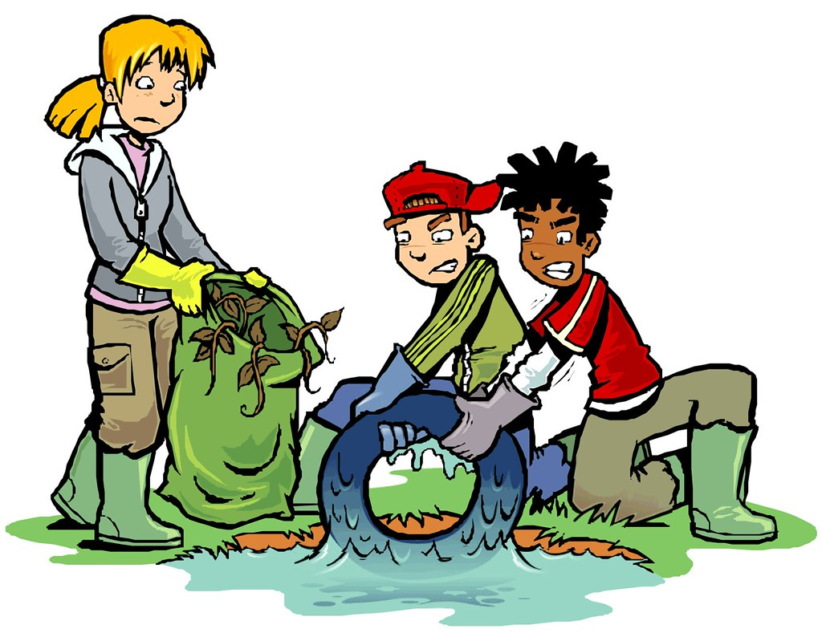
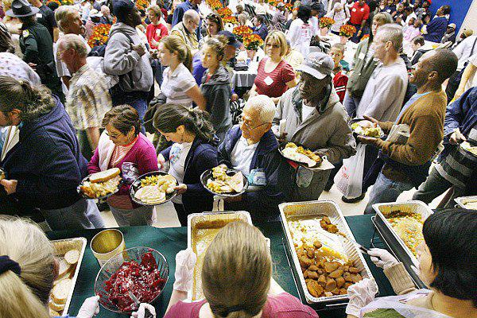

Social Enterprises want to help people
They use some or all their profits to do good things, like helping children go to school, feeding hungry people, or cleaning up the planet.

Slide 4


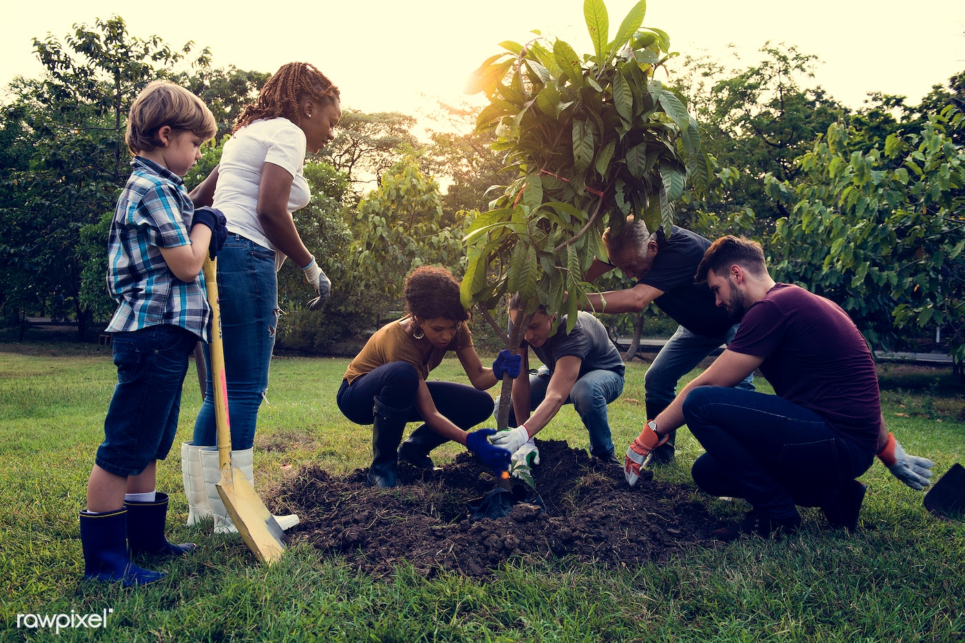
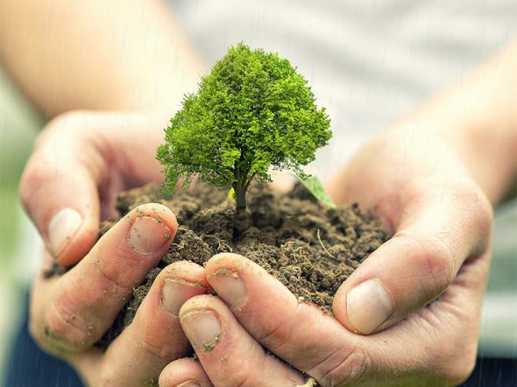
Saving the planet
They try to take care of our planet by recycling and using eco-friendly materials.
Some social enterprises plant trees to make the air cleaner

Slide 5
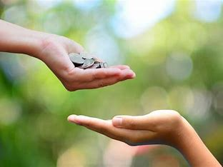
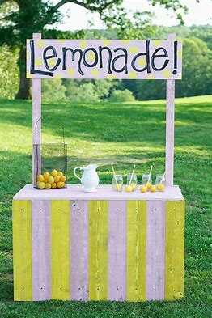
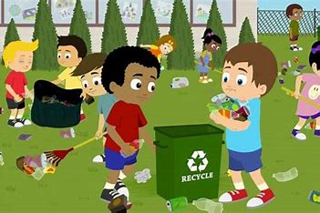

Making Money for Good
Social enterprises sell things, just like regular businesses, but they use the money they make to do good things.

Slide 6
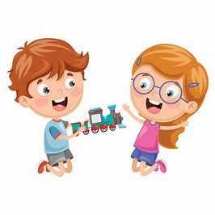
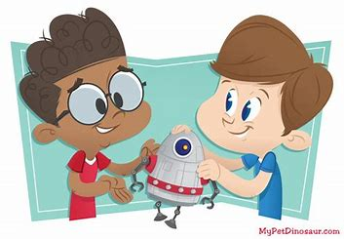
Sharing Profits
They don’t keep all the money for themselves. They use some to help people and the planet.
It's like sharing your toys with friends.

Slide 7

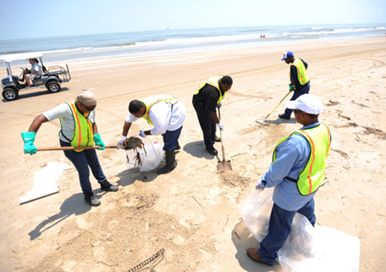
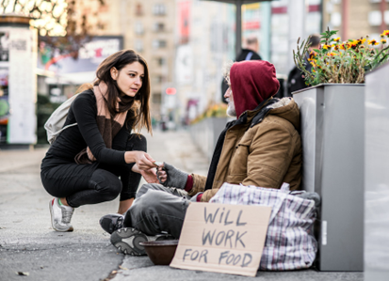

Why Social Enterprises Matter?
Social enterprises are important because they make the world a better place while still making money.

Slide 8
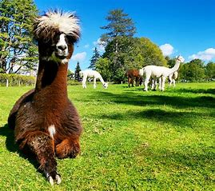
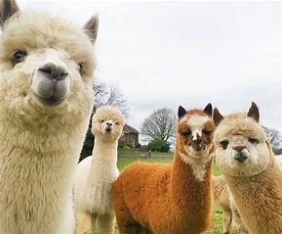
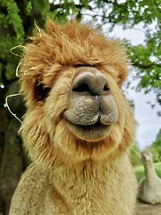
Example of a Cumbrian Social Enterprise…
Alpacaly Ever After…
Their mission is to rehome alpacas and llamas from all over the country and give them a wonderful new home with the very best of care, while bringing people in touch with the landscape and the natural world through outstanding alpaca and llama experiences.

