Slide 1



Slide 2
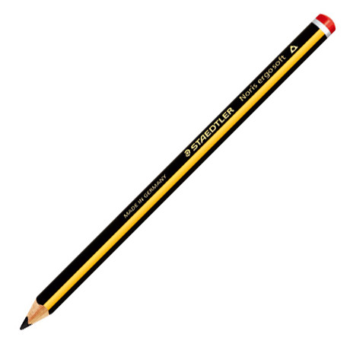
Who uses this?

Slide 3
Who uses this?
Reporter
Doctor
Builder
Teacher
Actor
Taxi Driver
Map maker
Artist
University tutor
Editor
Architect
TV presenter
Geographer
Engineer
Plumber
Nurse
Musician
Scientist
Pupil
Writer
Crossword creator
Train Driver
Designer
Carpenter
Journalist

Slide 4
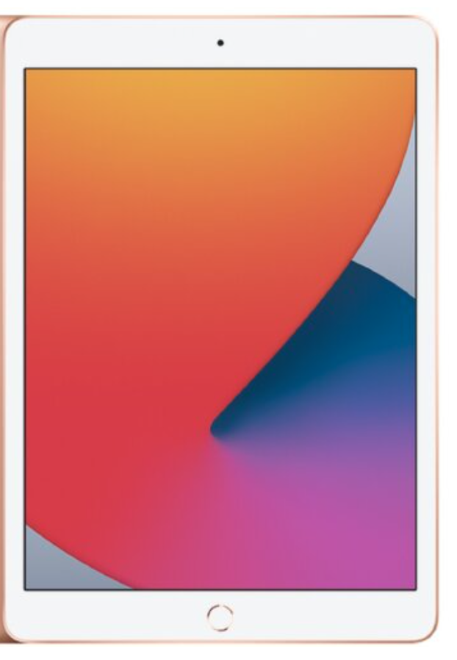
Who uses this?
Tablet Computer.

Slide 5

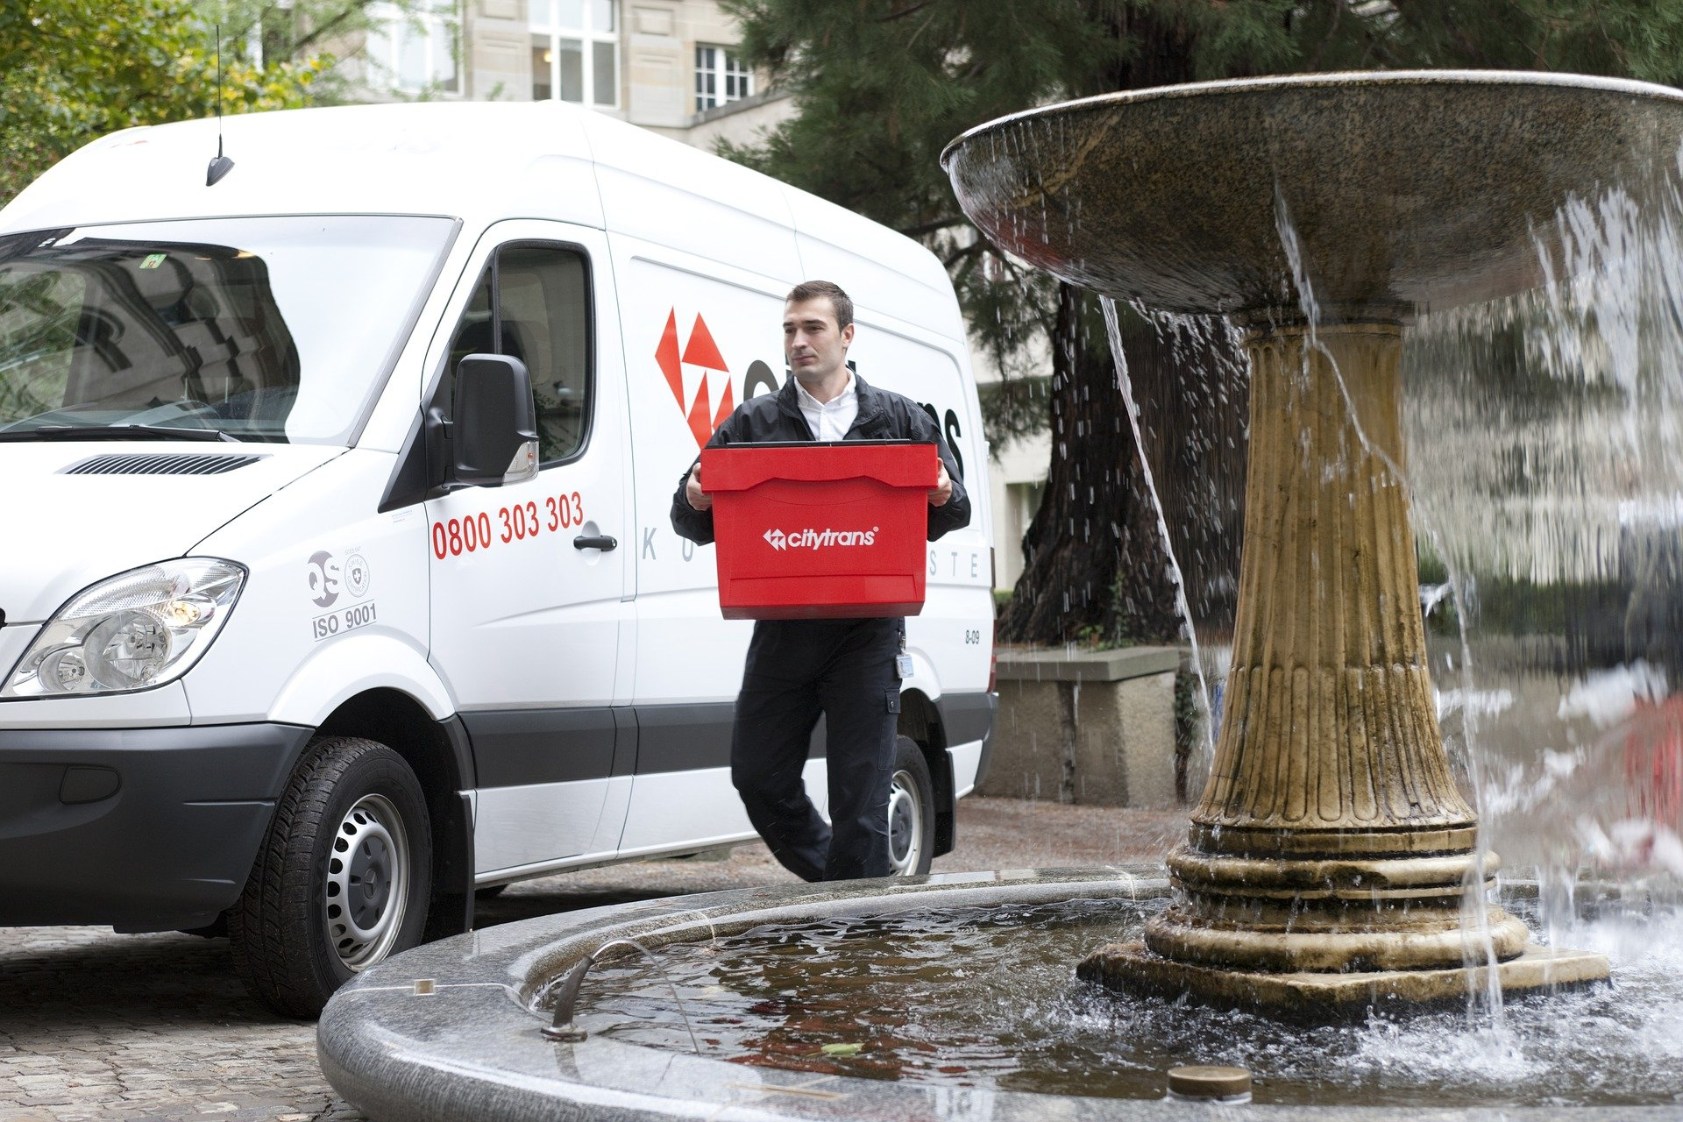
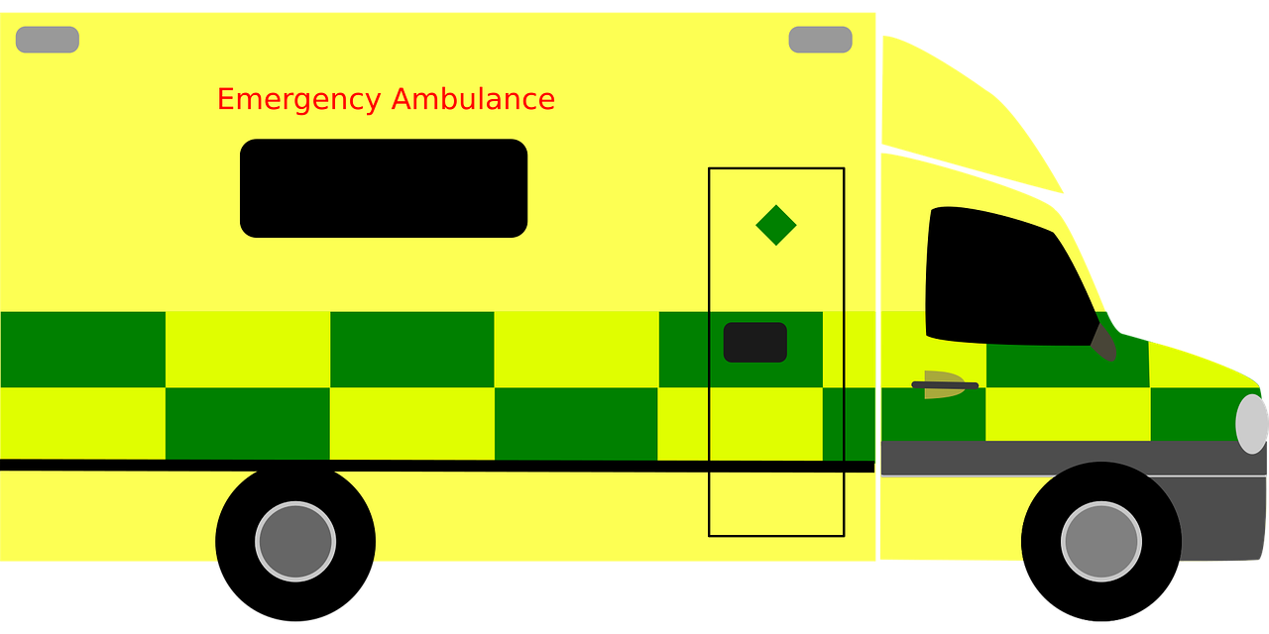
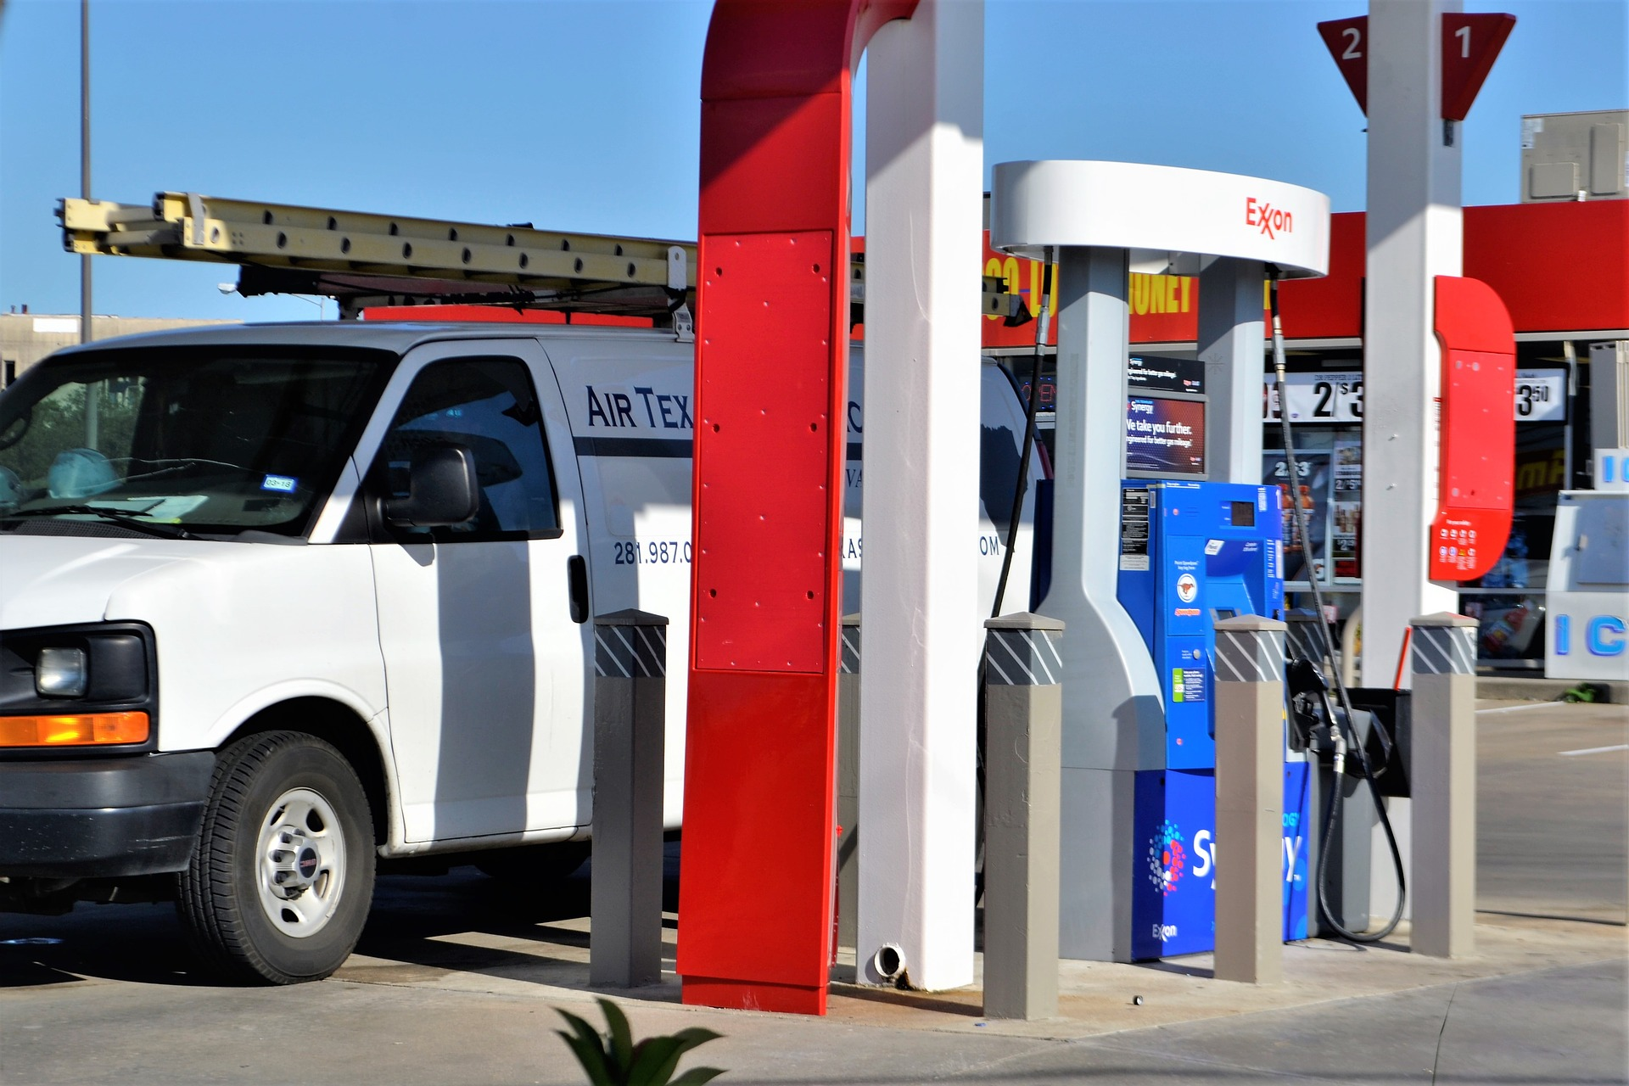
Who uses this?
A Van.

Slide 6
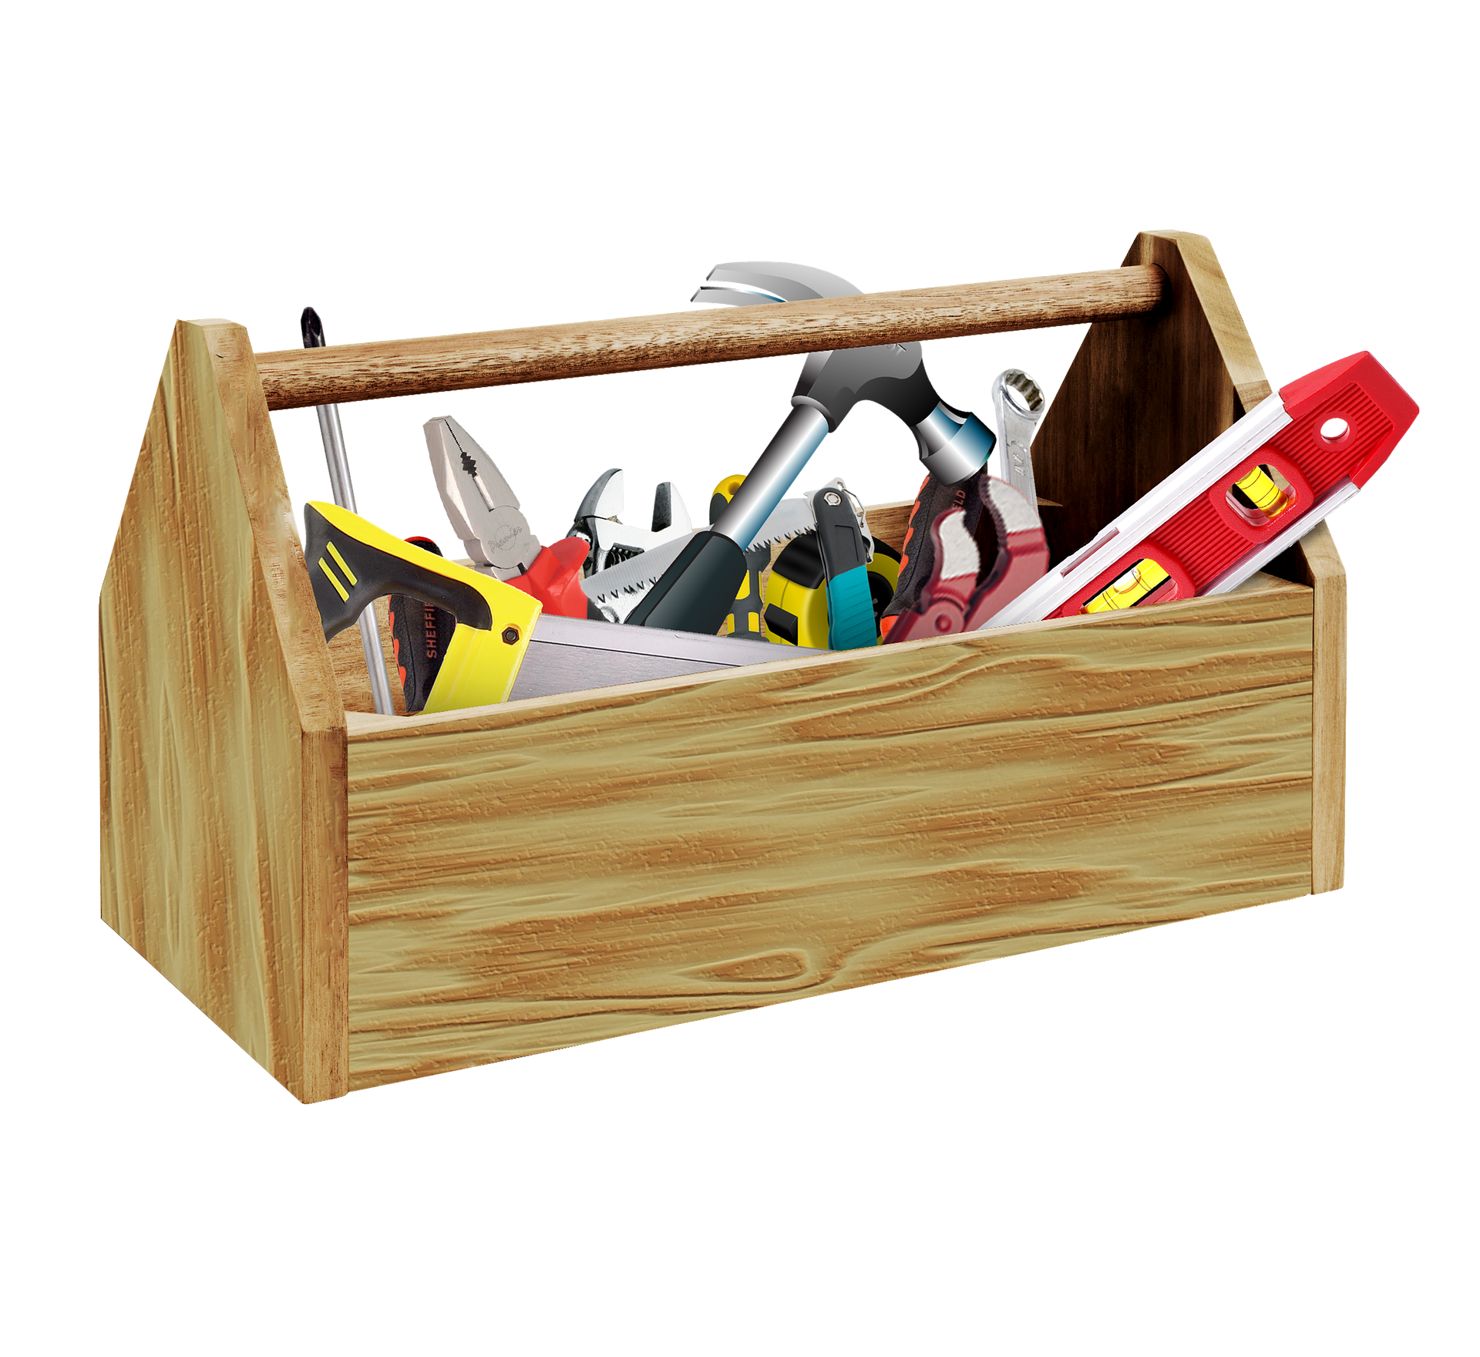
Who uses this?
A Toolbox.

Slide 7
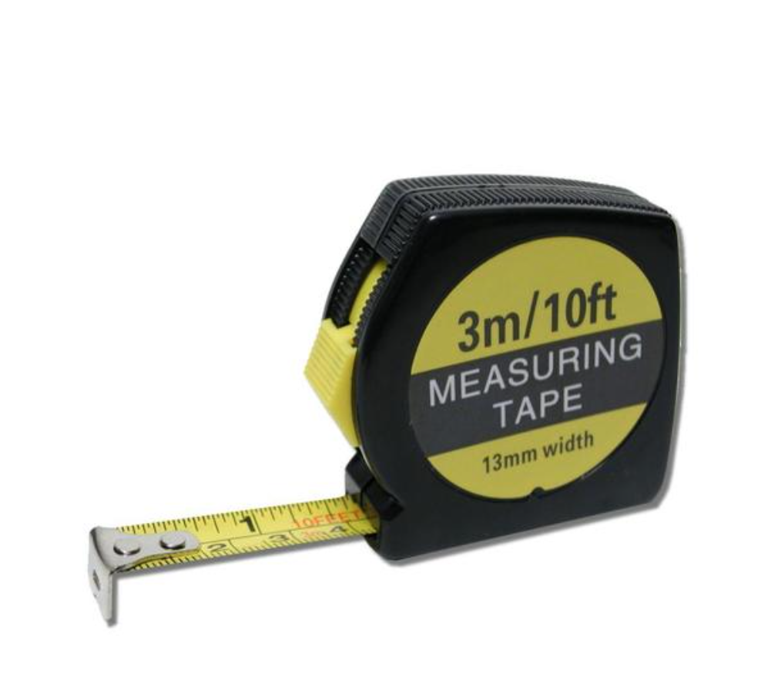
Who uses this?
A tape measure.

Slide 8
Who uses this?
YOUR PICTURE / OBJECT
?

Slide 9
Who uses this?
YOUR PICTURE / OBJECT
?

